Slide 1
Predicting Data Breaches with Machine Learning: A Focus on Data Type and Vulnerabilities
Yuta Sugiyama
WK01-WK12
Revision 2023.11.7
CDS-492 | Fall 2023 | Dr. Slamani

Slide 2
Week - 01

Slide 3
Outline
WK01 - Topic search
Topic title
Topic summary
Rationale
Possible issues
WK01 - Literature review
Paper title
Paper citation
Summary of what was investigated
Processing algorithms
What I liked about the paper
What additions I can provide to the topic

Slide 4
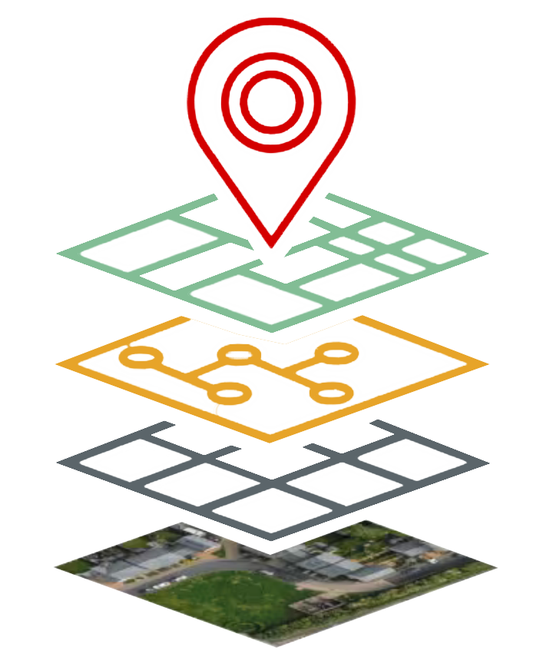
Topic Background
Topic summary
Data breaches occur when unauthorized people get a hold of private information, which has increased in its frequency and severity. These data breaches can lead to financial loss, harm a reputation, and result in legal trouble for the people and organizations involved. These breaches have increased in frequency and severity; therefore, experts are using sophisticated technologies like machine learning to forecast and prevent data breaches. In cybersecurity, there seems to be a missing component in efforts, which is geographical information.
In this study, The data breaches will be analyzed to identify regions or countries that are more susceptible to data breaches, considering factors like cyber-infrastructure, policies, and regulations.

Slide 5

Rationale
Benefits of Geographical Locations of Data Breaches
Predicting data breaches in regions could be used to give a localized risk assessment
Allocate more security and resources
Predict data breaches
Improve regulations and policies
Target security measures for the region

Slide 6
Foreseeable Issues
What issues can be expected to address the topic?
Data Integrity
Inaccurate or biased data can lead to incorrect predictions and decisions.
Privacy
When predicting and reducing data breaches, it's important to keep a balance between using data effectively and respecting privacy rights of individuals.
Feature selection
Identifying the most relevant features of the data, while removing noise is important
Bias and Generalization
It's important to ensure that predictions are not unfairly influenced by factors like race, gender, or other sensitive attributes.

Slide 7
WK01 – Literature Review | Paper 1
Paper title
Examining the correlates and spatial distribution of organizational data breaches in the United States
Paper citation
Khey, D. N., & Sainato, V. A. (2013). Examining the correlates and spatial distribution of organizational data breaches in the United States. Security Journal, 26(4), 367–382. https://doi.org/10.1057/sj.2013.24
Summary of what was investigated
The article investigates organizational data breaches in the United States, focusing on their geospatial patterns and situational prevention strategies. It explores the geographical distribution of data breaches across US counties and notes their clustering. The study used Routine Activity Theory and Situational Crime Prevention (SCP) to analyze these breaches. It discusses four dimensions of incident clusters: behaviors, place and space, persons, and time. The application of SCP techniques, like target hardening, access control, and self-policing, reduces the risk of data breaches and highlights the need for further research to better understand and mitigate this cybercrime issue.

Slide 8
WK01 – Literature Review | Paper 1 (cont.)
Processing algorithms
The article does not mention the specific processing algorithms used in each paper. It primarily discusses concepts, theories, and findings related to geospatial patterns of organizational data breaches and situational crime prevention strategies.
What I liked about the paper
I liked that this paper is a predecessor to what my research project will visually show and its integration of theories within its study.
What additions I can provide to the topic
This project will provide the research to further emphasize that data breaches are correlated by geospatial distribution, while visually depicting the detected anomalies in a region of a country in real-time.

Slide 9
Week - 02

Slide 10
Outline
WK02 – Review/revise work from previous week(s)
Summary of changes
WK02 – Literature review Paper 2
Paper title
Paper citation
Summary of what was investigated
Processing algorithms
What I liked about the paper
What additions I can provide to the topic
WK02 - Literature review Paper 3
Paper title
Paper citation
Summary of what was investigated
Processing algorithms
What I liked about the paper
What additions I can provide to the topic

Slide 11
WK02 – Review/revise work from previous week(s)
Below is a summary of changes made and slide numbers
Splitting up information about the topic chosen to discuss the background, benefits, and any foreseeable issues.
Elaborations on each topic category
Addition of diagrams and pictures
Literature Review slides

Slide 12
WK02 – Literature Review | Paper 2
Paper title
How Data Breaches Affect Consumer Credit
Paper citation
Mikhed, V., & Vogan, M. (2018). How data breaches affect consumer credit. Journal of Banking and Finance, 88, 192–207. https://doi.org/10.1016/j.jbankfin.2017.12.002
Summary of what was investigated
The study investigated the response of consumers to the 2012 South Carolina Department of Revenue data breach, focusing on their adoption of fraud protection services and changes in credit behavior. The study analyzed how affected individuals acquired different fraud protection services and examined whether news coverage of the breach influenced their responses. Geospatial data was utilized to understand how breach-related responses varied across different geographic areas, such as regions that shared media markets across states. Overall, this study wanted to find a correlation of knowing about a data breach affects people taking steps to increase their security.
Results
People who were directly affected by the data breach were more likely to get fraud protection services, but the breach didn't really change their credit card use or other financial behaviors. Interestingly, people who heard about the breach in the news but weren't directly affected didn't seem to take extra steps to protect themselves, showing that just knowing about a breach might not make people act differently.

Slide 13
WK02 – Literature Review | Paper 2
What processing algorithms did the paper use
The paper used statistical analysis techniques such as logistic regression to process and analyze the data, and geospatial data analysis to understand how individuals in different geographic areas responded to the breach and news coverage.
What you liked about the paper
I liked how important questions about consumer behavior and the impact of data breaches on individuals' decisions to adopt fraud protection measures were addressed. Also, the use of geospatial data adds an interesting dimension to the analysis, allowing for insights into regional variations in responses to data breach information.
What additions you can provide to the topic
ML can be used to develop predictive models that forecast individuals' likelihood of adopting fraud protection measures after a data breach. ML algorithms could provide more accurate insights into the factors influencing post-breach behaviors, assisting in consumer protection and communication.

Slide 14
WK02 – Literature Review | Paper 3
Paper title
Modified VAST Challenge with Applications to Data Breaches
Paper citation
Carr, R. Modified VAST Challenge with Applications to Data Breaches. Challenge, 2, 9.
Summary of what was investigated
This scholarly article focused on developing interactive tools to visualize and explore a recontextualized dataset from the 2021 VAST Challenge Mini Challenge 2. Specifically, it explored ways to link credit card and loyalty card data to uncover patterns and anomalies. The investigation also delved into using geospatial data to trace the movements of employees and identify potential security risks.
Results
Challenges arose within this study due to complex data and unworkable geospatial information, making certain aspects of the investigation difficult to accomplish. .

Slide 15
WK02 – Literature Review | Paper 3
What processing algorithms did this paper use
The processing algorithms used are data linking, data abstraction and exploration, geospatial data conversion, and data cleaning.
What you liked about the paper
I like how the paper chooses practical data processing techniques for the dataset, iwhich includes: data abstraction, geospatial conversion, and interactive visualization, to explore the dataset's nuances and limitations.
What additions you can provide to the topic
I could add ML anomaly detection algorithms or clustering techniques, which can help identify unusual patterns/relationships in the data that might identify potential breaches or suspicious activities.

Slide 16
WK02 – Synthesis Matrix
Sources | Research question/hypothesis | Methods | Findings | Strengths | Limitations
Where is the current work located? Reference to source. Must use a consistent citation format. | What issue is the paper addressing? The research question that the paper sets out to answer, or a hypothesis that the authors set out to support or disprove. | How was it performed? What approaches, methods, tools and techniques were used? | What did they find? Describes the data that was collected and the results of any statistical tests/analysis that were performed. | What was particularly good about the paper? This section typically highlights the major contribution about the current work. | What were the shortcoming of the current work? What could be done to improve the current work.
Paper 1 | How are organizational data breaches distributed geospatially in the United States? What are the underlying factors contributing to these distribution patterns? | Data collection, Routine Activity Theory, Situational Crime Prevention (SCP), and geospatial analysis. | Evidence supporting the geospatial clustering of data breaches in specific US counties. Implementation of measures like target hardening and access control reduces the occurrence of data breaches. | The applied theory, geospatial analysis, and situational prevention strategies. | Data quality, generalization of other countries, and various factors and aspects unknown.
Paper 2 | How do data breaches affect consumer credit behavior, adoption of fraud protection services, and response to news coverage of breaches? | Data collection, Logistic regression, geospatial analysis, and comparison of affected and unaffected. | Individuals directly affected by the data breach were more likely to adopt fraud protection services. The breach didn’t significantly change the credit card use or other financial behaviors of affected individuals. Individuals who heard about the breach in the news but were not directly affected did not exhibit significant changes in behavior. | Real world applications, showing the affect of data breaches. Geospatial analysis giving valuable insights into how breach-related responses vary across different geographic areas, | Data source accuracy, long-term behavioral changes, and external factors.
Paper 3 | How can interactive visualization tools and practical data processing techniques be applied to recontextualized datasets to uncover patterns, anomalies, and potential security risks, particularly in the context of data breaches? | Data linking, geospatial data conversion, and data visualization. | The dataset presented challenges due to its complexity and unworkable geospatial data. Data abstraction, geospatial conversion, and interactive visualization were effective techniques for uncovering insights. | The data processing addresses real-world challenges within complex datasets. | Complexity of data and its application to specific scenarios and data quality.

Slide 17
WK02 – Data Search
Where did you find the data
I found the dataset on the state of Massachusetts's website of the Office of Consumer Affairs and Business Regulation. https://www.mass.gov/lists/data-breach-reports
Describe the relevancy of the data to your project
It was difficult to find a dataset with data breaches with a specific location, but this dataset can be useful due to it having the business entities, which is only in the state of Massachusetts. This can help pinpoint what companies or areas have the most breaches. The dataset is a report of data breaches of businesses within Massachusetts and includes their assigned breach number, date, organization name, breach type, residents affected, and if the SSN, bank account number, driver license, and credit/debit card are compromised.

Slide 18
Week - 03

Slide 19
Outline
WK03 – Review/revise work from previous week(s)
Summary of changes
WK03 – Class Folder
Creation of shared project folder
WK03 – Workflow Diagram
WK03 – Project Purpose and Questions
Purpose
Motivation
Examples to explain motivation
Benefits: affected stakeholders and how
Research questions
Revised Title
WK03 – Data
Data information
Format
Variable information
Statistical analysis of numerical values
Plot of 2 parameters

Slide 20
WK03 – Review/revise work from previous week(s)
Below is a summary of changes made and slide numbers
More Readable title for the Project
Split up Literature reviews for readability

Slide 21
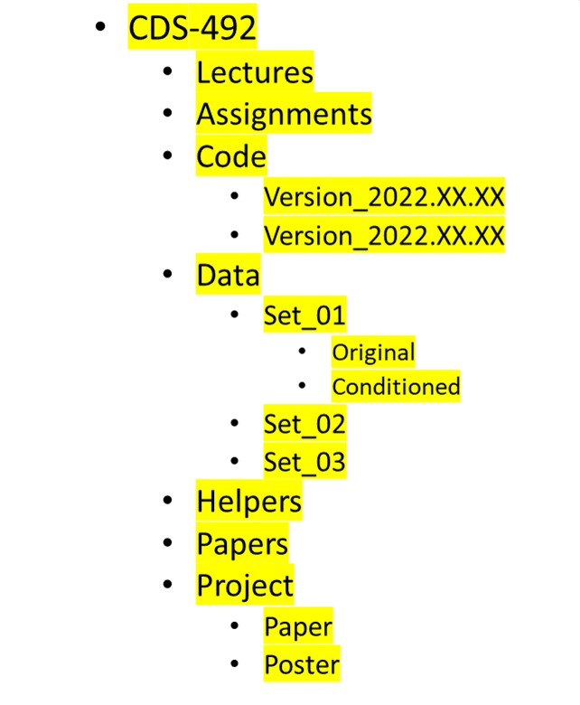
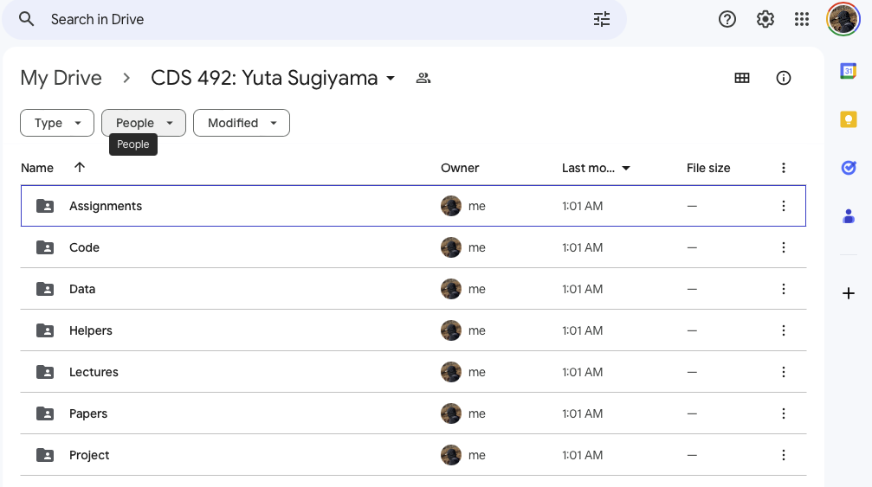
WK03 – Class Folder
Class Folder
Create a folder structure as shown in the picture
Put files in respective folders (e.g., papers, assignments, etc.)
Put the folder in Onedrive or Google Drive
Share the folder with the teacher (aslaman@gmu.edu)
Screenshot of created folder

Slide 22
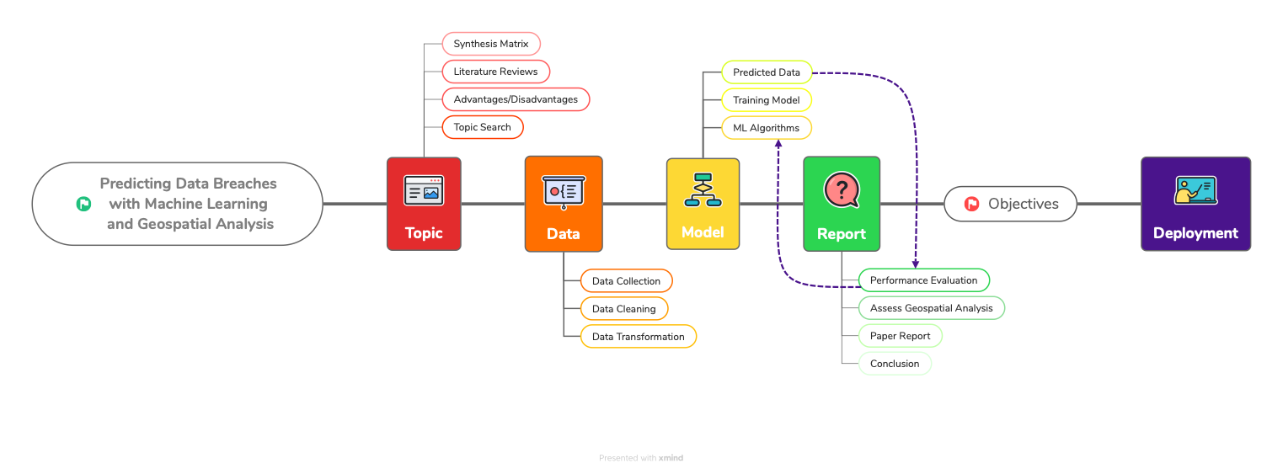
WK03 – Workflow diagram

Slide 23
WK03 – Project Purpose and Questions
Project purpose
The purpose of this project is to utilize machine learning and geospatial analysis to predict and determine organized data breaches by considering the type of PPI targeted (e.g., credit card information, social security numbers) and the geographical locations where these breaches occur.
Motivation
The motivation for this project is from the increasing frequency and severity of data breaches, which have significant consequences, including financial losses, reputation damage, and legal ramifications. The existing cybersecurity efforts often lack a geographical component; therefore, making this essential to incorporate geographic information to enhance breach prediction and prevention strategies.
Examples to explain the motivation for the project topic
Major retail chains have faced substantial financial losses and damage to their reputation due to data breaches, highlighting the urgent need for more precise and location-aware breach prediction strategies.
Government agencies have struggled to protect citizens' sensitive information in different regions, and the project aims to provide them with tools to tailor their cybersecurity measures based on geographical risk factors.

Slide 24
WK03 – Project Purpose and Questions
Benefit(s) of the project (benefits who and how)
Benefits | Localized Risk Assessment | Targeted Resource Allocation | Improving Regulations and Policies | Targeted Security Measures
Who | Any type of organization, government agencies, businesses operating in different regions, and individuals/consumers. | Any type of organization, government agencies, and businesses operating in different regions. | Policymakers, regulatory bodies, and government agencies responsible for cybersecurity. | Any type of organization, government agencies, businesses operating in different regions, and individuals/consumers.
How | By analyzing data breaches in relation to geographical locations, stakeholders can identify regions that are at a higher risk of data breaches | Predictive analysis can help these entities allocate their resources, such as cybersecurity personnel, tools, and budgets, more efficiently. | By gaining insights into data breach patterns across different regions, policymakers and regulatory bodies can develop and enhance regulations and policies that address regional vulnerabilities. | With a better understanding of which regions and data types are at higher risk, entities can implement targeted security measures.

Slide 25
WK03 – Project Purpose and Questions
Research questions
Are certain geographical regions more susceptible to data breaches than others?
Can ML models effectively predict data breaches by analyzing both the type of data targeted (e.g., credit card information, social security numbers) and the geographical locations where they occur?
Is there evidence to suggest that some data breaches are organized, and if so, can geospatial analysis provide insights into the patterns and motivations behind organized data breaches?
Revised title (if needed)
Predicting Data Breaches with Machine Learning and Geospatial Analysis: A Focus on Data Type and Regional Vulnerabilities

Slide 26
WK03 – Data
Data Information
Size of the data (This will be larger as I complete the entire dataset from 2007-2023)
Number of columns: 13
Number of rows: 1603
File size in MB: 0.122MB
Format
The format was in PDF for each report year
I will compile a dataset from 2007-2023 reports into a CSV file.

Slide 27
WK03 – Data
Column | Assigned Breach Number 1 | Date Reported 2 | Organization Name 3 | Breach Type Description 4 | Breach Occurrence at Reporting Entity? 5 | MA Residents Affected 6 | SSN Breached? 7 | Account Number Breached? 8 | Driver’s Licenses Breached? 9 | Credit Debit Numbers Breached? 10 | Provided Credit Monitoring 11 | Data Encrypted 12 | Mobile Device Lost Stolen 13
Data Type | Numerical | Date | Categorical | Categorical | Boolean | Numerical | Boolean | Boolean | Boolean | Boolean | Boolean | Boolean | Boolean
Description | A unique identifier for each data breach incident. | The date when the data breach occurred. | The name of the business or organization affected by the data breach. | The format in which the data was compromised, such as "Electronic" or "Paper.” | Whether the breach occurred at the reporting entity. | How many Massachusetts residents were affected by this breach | Whether Social Security Numbers (SSNs) were compromised, with values like "Yes" or empty cells. | Whether account numbers were compromised. | Whether driver’s license numbers were compromised. | Whether credit/debit card numbers were compromised. | Whether the organization offers credit monitoring to individuals/consumers. | Whether data was encrypted or not for that organization. | Whether mobile device was lost or stolen.

Slide 28
WK03 – Data
Statistical Analysis of Numerical Values
Statistic | Assigned Breach Number | MA Residents Affected
Min | 28815.000000 | 0.000000e+00
Max | 30438.000000 | 2.109381e+06
Mean | 29630.948222 | 2.557919e+03
Median | 29631.000000 | 4.000000e+00
Standard Deviation | 465.385347 | 5.434073e+04

Slide 29
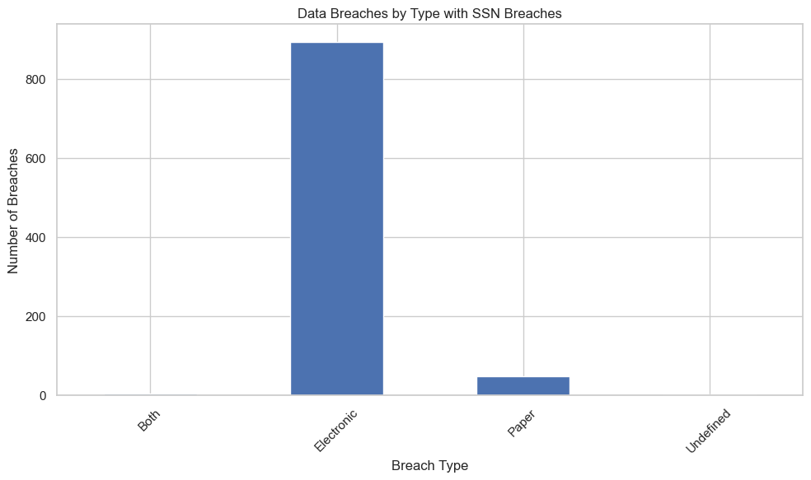
WK03 – Data
Plot of parameters SSNBreached and Data Breach Description

Slide 30
Week - 04

Slide 31
Outline
WK04 – Review/revise work from previous week(s)
Summary of changes
WK04 – Project Workflow
Updated Project Workflow Diagram
WK04 – Code Workflow
WK04 – Updated Data
Updated Information About Data
Table of Statistics
Plot of Parameters
WK04 – Project Purpose and Questions
Purpose
Motivation
Examples to explain motivation
Benefits: affected stakeholders and how
Research questions
Project objectives
WK04 – Objectives and Parameters

Slide 32
WK04 – Review/revise work from previous week(s)
Below is a summary of changes made and slide numbers
Updated Project Workflow Diagram
Downsizing Phases
Less details
Adding Report phase and subtopics
Data is now updated to the full extent from 2007-2022
Not the 2023 report, due to the goal of the project (predicting and then matching the predicted dataset to the 2023 report)
Zoom call is delayed (person of contact needed to reschedule [date TBD])
Assumption has been affirmed that blanks in the dataset means no instead of null data
During data cleaning/transformation process, I will have to encode “” to mean False or 0 for all Boolean variables.
Organize Data Column Description and Topic Benefits into Table

Slide 33
WK04 – Project Workflow

Slide 34
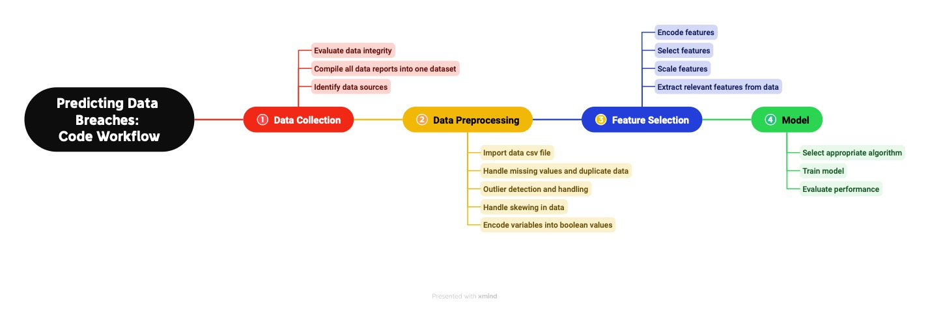
WK04 – Code Workflow

Slide 35
WK04 – Updated Data
Data Information
Size of the data
Number of columns: 13
Number of rows: 22994
File size in MB: 1.5MB
Format
The original format was in PDF for each report year, which were converted to a XLSX file then, a CSV file.
The dataset from 2007-2022 reports are in a CSV file.
The 2023 Report will be compared to the predicted dataset.

Slide 36
WK04 – Updated Data (2)
Column | Assigned Breach Number 1 | Date Reported 2 | Organization Name 3 | Breach Type Description 4 | Breach Occurrence at Reporting Entity? 5 | MA Residents Affected 6 | SSN Breached? 7 | Account Number Breached? 8 | Driver’s Licenses Breached? 9 | Credit Debit Numbers Breached? 10 | Provided Credit Monitoring 11 | Data Encrypted 12 | Mobile Device Lost Stolen 13
Data Type | Numerical | Date | Categorical | Categorical | Boolean | Numerical | Boolean | Boolean | Boolean | Boolean | Boolean | Boolean | Boolean
Description | A unique identifier for each data breach incident. | The date when the data breach occurred. | The name of the business or organization affected by the data breach. | The format in which the data was compromised, such as "Electronic" or "Paper.” | Whether the breach occurred at the reporting entity. | How many Massachusetts residents were affected by this breach | Whether Social Security Numbers (SSNs) were compromised, with values like "Yes" or empty cells. | Whether account numbers were compromised. | Whether driver’s license numbers were compromised. | Whether credit/debit card numbers were compromised. | Whether the organization offers credit monitoring to individuals/consumers. | Whether data was encrypted or not for that organization. | Whether mobile device was lost or stolen.

Slide 37
WK04 – Updated Data (3)
Sample Data
Assigned Breach Number | Date Reported To OCA | Organization Name | Breach Type Description | Breach Occur at the Reporting Entity? | MA Residents Affected | SSN Breached | Account Number Breached | Drivers Licenses Breached | Credit Debit Numbers Breached | Provided Credit Monitoring | Data Encrypted | Mobile Device Lost Stolen
250 | 8/16/2007 | Hewlett Packard Company | Electronic |  | 52 | Yes |  |  |  | Yes |  | Yes
252 | 9/11/2007 | Kraft Foods | Electronic |  | 460 | Yes |  |  |  | Yes |  | Yes
244 | 9/12/2007 | The Hartford | Electronic |  | 18 | Yes | Yes |  |  | Yes
270 | 9/21/2007 | Symantec Corporation | Undefined |  | 1 | Yes |  |  |  | Yes
243 | 10/5/2007 | The Hartford | Electronic |  |  | Yes |  | Yes |  |  |  | Yes

Slide 38
WK04 – Updated Data (4)
Statistical Analysis of Numerical Values
Statistic | MA Residents Affected
Min | 0
Max | 2982421
Mean | 715
Median | 3
Standard Deviation | 24198
The maximum of 2,982,421 indicates that in some instances, a very large number of Massachusetts residents were affected. This is probably due to a significant event or disaster.
This is around 715 on average. This value gives us an idea of the typical number of residents affected when looking at the dataset.
The median value for MA Residents Affected is 3, which is significantly lower than the mean. This suggests that half of the data points have fewer than 3 Massachusetts residents affected.
The standard deviation is 24,189, which is a high standard deviation. This indicates that the data points are widely spread out from the mean.

Slide 39
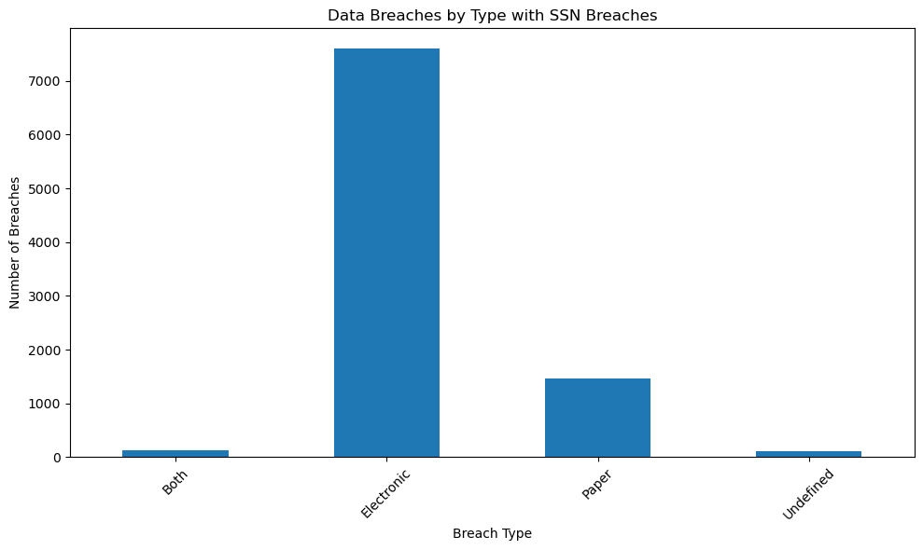
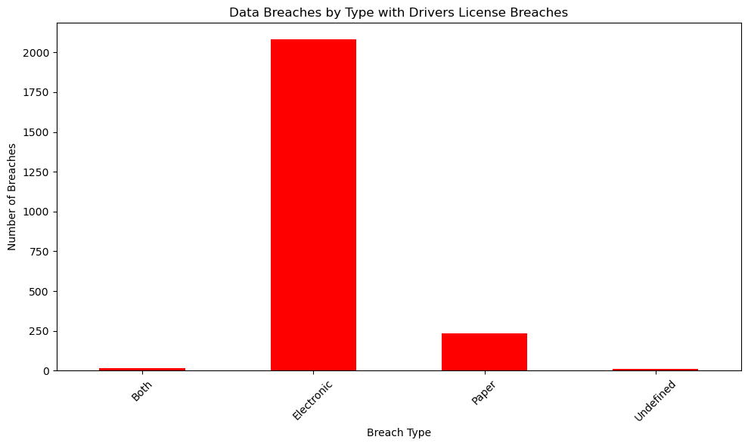
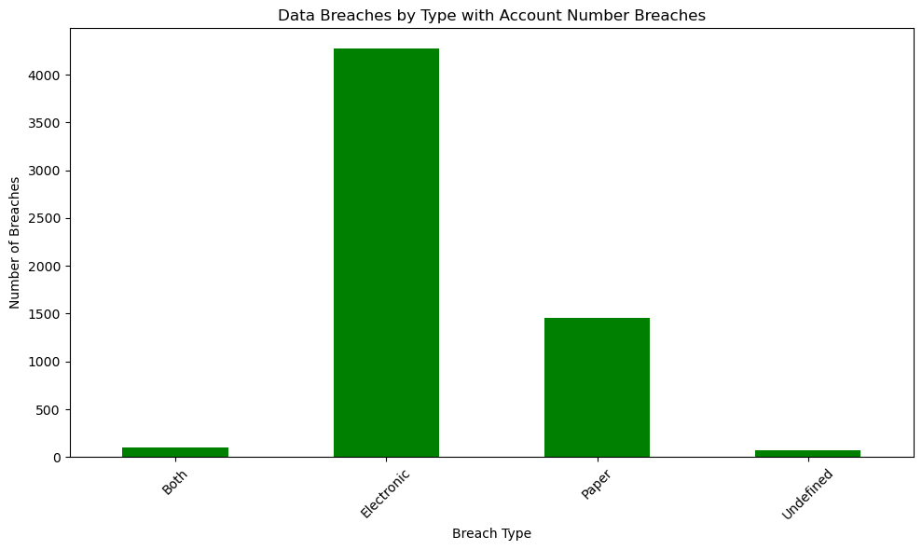
WK04 – Updated Data (5)
With the new and complete dataset, we can see the proportion of targeted data breaches that are electronic, paper, undefined, or both electronic and paper.
In this plot, approximately 38% of the data breaches were by paper.

Slide 40
WK04 – Project Purpose and Questions
Project purpose
The purpose of this project is to predict and determine organized data breaches by considering the type of Personal Personally Identifiable Information (PPI) targeted, such as credit card information or social security numbers, and pinpointing the geographical regions where these breaches are most likely to occur.
Motivation
This project’s motivation stems from the alarming rise in both the frequency and severity of data breaches, which cause issues such as financial setbacks, reputation tarnishing, and legal entanglements. Current cybersecurity efforts frequently overlook a geographical component. This highlights the importance of including geographic data to strengthen our ability to predict and prevent data breaches.
Examples to explain the motivation for the project topic
Major retail chains have faced substantial financial losses and damage to their reputation due to data breaches, highlighting the urgent need for more precise and location-aware breach prediction strategies.
Government agencies have struggled to protect citizens' sensitive information in different regions, and the project aims to provide them with tools to tailor their cybersecurity measures based on geographical risk factors.

Slide 41
WK04 – Project Purpose and Questions (2)
Benefit(s) of the project (benefits who and how)
Benefits | Localized Risk Assessment | Targeted Resource Allocation | Improving Regulations and Policies | Targeted Security Measures
Who | Any type of organization, government agencies, businesses operating in different regions, and individuals/consumers. | Any type of organization, government agencies, and businesses operating in different regions. | Policymakers, regulatory bodies, and government agencies responsible for cybersecurity. | Any type of organization, government agencies, businesses operating in different regions, and individuals/consumers.
How | By analyzing data breaches in relation to geographical locations, stakeholders can identify regions that are at a higher risk of data breaches | Predictive analysis can help these entities allocate their resources, such as cybersecurity personnel, tools, and budgets, more efficiently. | By gaining insights into data breach patterns across different regions, policymakers and regulatory bodies can develop and enhance regulations and policies that address regional vulnerabilities. | With a better understanding of which regions and data types are at higher risk, entities can implement targeted security measures.

Slide 42
WK04 – Project Purpose and Questions (4)
Research questions
Are certain geographical regions more susceptible to data breaches than others?
Is there evidence to suggest that some data breaches are organized?
Can the predicted output explain patterns and motivations behind organized data breaches and insights about their targets?
Project Objectives
Identify regions with varying vulnerabilities to data breaches.
Find evidence of organized data breach activities.
Create a predictive model to understand the patterns and motivations behind organized data breaches and their target selection.

Slide 43
WK04 – Objectives and Parameters
Objectives | Identify regions with varying vulnerabilities to data breaches. | Find evidence of organized data breach activities. | Create a predictive model to understand the patterns and motivations behind organized data breaches and their target selection.
Parameters | Geographical Data Organization Names Possibly demographic info about MA regions MA Residents Affected Provided Credit Monitoring? Mobile Device Lost or Stolen? Data Encrypted? | Geographical Data Organization Names Targeted Data Breached? SSN Credit/Debit Account number Driver’s License | Geographical Data Organization Names Targeted Data Breached? SSN Credit/Debit Account number Driver’s License MA Residents Affected

Slide 44
Week - 05

Slide 45
Outline
WK05 – Review/revise work from previous week(s)
Summary of changes
WK05 – Project Workflow Updated
Updated Project Workflow Diagram
WK05 – Code Workflow Updated
Updated Code Workflow Diagram
WK05 – Updated Data
Updated Information About Data
Table of Statistics (do not have many numerical values)
Plot of Parameters
WK05 – Project Purpose and Questions
Purpose
Motivation
Examples to explain motivation
Benefits: affected stakeholders and how
Research questions
Project objectives
WK05 – Objectives and SMART
WK05 – Updated Objectives and Parameters

Slide 46
WK05 – Review/revise work from previous week(s)
Below is a summary of changes made and slide numbers
Changed plots into faceted plot (more readable)
Better statistic table with explanations of results.
Modified Code Workflow and Project Workflow
Broke off Analysis Phase from Reporting Phase
Updated Objectives and parameters table
Check marks for each parameter column
Highlighted data that’s either not used (red) or not yet attained (yellow)
Reviewed Project motivation, purpose, research questions, objectives, benefits, and examples
Decided that what I currently have does align with the SMART guide.
Elaborated on Specifics, Measurability, Achievability, Relevancy, and Time-bound for each objective

Slide 47
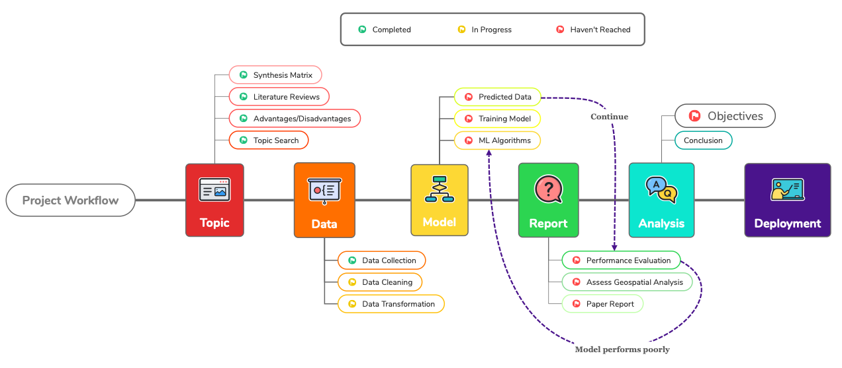
WK05 – Project Workflow Update

Slide 48
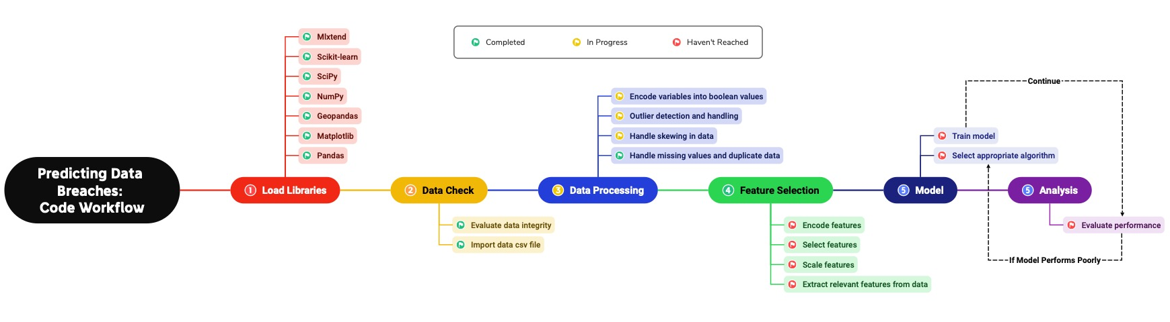
WK05 – Code Workflow Update

Slide 49
WK05 – Updated Data (1)
Statistical Analysis of Numerical Value (MA Residents Affected is the only numerical columns)
Statistic | MA Residents Affected
Min | 0
Max | 2982421
Mean | 715
Median | 3
Standard Deviation | 24198
The maximum of 2,982,421 indicates that in some instances, a very large number of Massachusetts residents were affected. This is probably due to a significant event or disaster.
This is around 715 on average. This value gives us an idea of the typical number of residents affected when looking at the dataset.
The median value for MA Residents Affected is 3, which is significantly lower than the mean. This suggests that half of the data points have fewer than 3 Massachusetts residents affected.
The standard deviation is 24,189, which is a high standard deviation. This indicates that the data points are widely spread out from the mean.

Slide 50
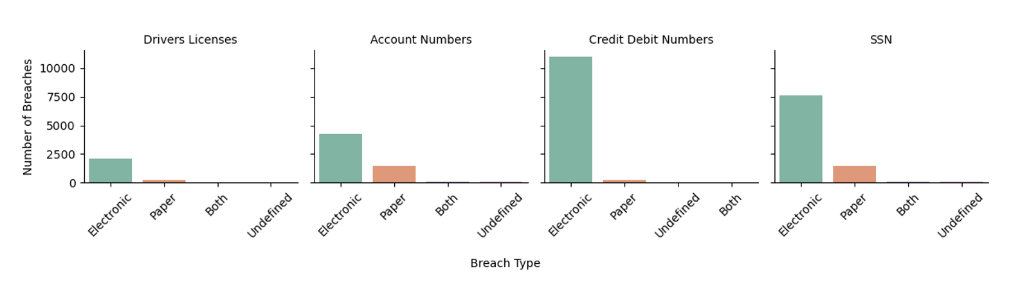
WK05 – Updated Data (2)
Facet Plot with 5 parameters
This is a facet plot that represents the number of data breaches based on different breach types.
Explanation of the lowest and highest values for each plot:
Credit/Debit Numbers has the highest count of electronic type data breaches, while Driver’s licenses has the lowest.
They both have about the same count of paper type breaches.
Approximately 40% of the total count of account number data breaches are paper type breaches.

Slide 51
WK05 – Project Purpose and Questions (1) (Revise)
Project purpose
The purpose of this project is to predict and determine organized data breaches by considering the type of Personal Identifiable Information (PII) targeted, such as credit card information or social security numbers, and pinpointing which organizations are most likely to have another data breach occur.
Motivation
This project’s motivation stems from the alarming rise in both the frequency and severity of data breaches, which cause issues such as financial setbacks, reputation tarnishing, and legal entanglements. This highlights the importance of using aspects of the data breaches to strengthen our ability to predict and prevent data breaches. This allows these organizations to proactively strengthen their security protocols.
Examples to explain the motivation for the project topic
Major retail chains have faced substantial financial losses and damage to their reputation due to data breaches, highlighting the urgent need for more precise breach prediction strategies.
Government agencies have struggled to protect citizens' sensitive information in different regions, and the project aims to provide them with tools to tailor their cybersecurity measures based on aspects of data breaches reports.

Slide 52
WK05 – Project Purpose and Questions (2) (Revise)
Benefit(s) of the project (benefits who and how)
Benefits | Localized Risk Assessment | Targeted Resource Allocation | Improving Regulations and Policies | Targeted Security Measures
Who | Any type of organization, government agencies, businesses operating in different regions, and individuals/consumers. | Any type of organization, government agencies, and businesses operating in different regions. | Policymakers, regulatory bodies, and government agencies responsible for cybersecurity. | Any type of organization, government agencies, businesses operating in different regions, and individuals/consumers.
How | By analyzing data breaches in relation to targeted data and security information, stakeholders can identify regions that are at a higher risk of data breaches | Predictive analysis can help these entities allocate their resources, such as cybersecurity personnel, tools, and budgets, more efficiently. | By gaining insights into data breach patterns across different organizations, policymakers and regulatory bodies can develop and enhance regulations and policies that address regional vulnerabilities. | With a better understanding of which organizationsand data types are at higher risk, entities can implement targeted security measures.

Slide 53
WK05 – Project Purpose and Questions (3) (Revise)
Research questions
Are certain organizations more susceptible to data breaches than others?
Is there evidence to suggest that some data breaches are organized?
Can the predicted output explain patterns and motivations behind organized data breaches and insights about their targets?
Project Objectives
Identify organizations with varying vulnerabilities to data breaches.
Find evidence of organized data breach activities.
Create a predictive model to understand the patterns and motivations behind organized data breaches and their target selection.

Slide 54
WK05 – Objectives and SMART (1)
Objective 1 | Identify organizations with varying vulnerabilities to data breaches.
Specific | Organizations with the most/less breaches over time will be identified.
Measurable | By quantifying and comparing the vulnerabilities within different organizations, through a vulnerability score or index or through EDA.
Achievable | Conducting vulnerability assessments for different organizations.
Relevant | Understanding organization vulnerabilities is crucial for predicting data breaches within the cybersecurity industry.
Time-bound | Organizations will be identified by Week 7 or 8
Objective 2 | Find evidence of organized data breach activities.
Specific | Aiming to locate areas with the same type of data breach and targeted data.
Measurable | By finding a presence within the type of breach and targeted data within that region.
Achievable | Investigating and analyzing data to detect patterns of organized data breaches.
Relevant | Addresses the objective of identifying organized breach activities within an organization.
Time-bound | Evidence will be identified in Week 8 or 9

Slide 55
WK05 – Objectives and SMART (2)
Objective 3 | Create a predictive model to understand the patterns and motivations behind organized data breaches and their target selection.
Specific | Identifying the motivations behind data breaches by finding relationships between breaches using location, organization info, and target selection.
Measurable | Predictive model will be analyzed based on its accuracy in performance.
Achievable | Using ML python libraries and data analysis techniques.
Relevant | Understanding the underlying factors and motivations behind hackers and cyber criminals
Time-bound | Predictive Model will be completed in Week 10
After Week 10, I will be refining the project and working on communicating the results.

Slide 56

WK05 – Objectives and parameters (Review)
 | Assigned Breach Number | Date Reported | Organization Name | Breach Type Description | Breach Occurrence at Reporting Entity? | MA Residents Affected | SSN Breached? | Account Number Breached? | Driver’s Licenses Breached? | Credit Debit Numbers Breached? | Provided Credit Monitoring | Data Encrypted | Mobile Device Lost Stolen
Identify regions with varying vulnerabilities to data breaches.
Find evidence of organized data breach activities.
Create a predictive model to understand the patterns and motivations behind organized data breaches and their target selection.
Parameters
Objectives

Slide 57
Week - 06

Slide 58
Outline
WK06 – Review/revise work from previous week(s)
Summary of changes
WK06 – What was done this week
Summary of what was done this week
WK06 – Project Workflow Updated
Updated Project Workflow Diagram
WK06 – Code Workflow Updated
Updated Code Workflow Diagram
WK06 – Data Cleaning
WK06 – Coding
What was done
WK06 – Survey

Slide 59
WK06 – Review/revise work from previous week(s)
Below is a summary of changes made and slide numbers
Took out the Geospatial Analysis Aspect from the entire project due to the lack of response from the dataset source.
Motivation changed
Purpose changed
Examples changed
Objective 1 changed
Research question 1 changed
Topic description and research changed
Project Workflow Revised
Need stats table after outlier handling and detection

Slide 60
WK06 – What was done this week
Below is a summary of what was done this week
Data Cleaning and Encoding
Updated Project and Code Workflow Diagram
Coding
Importing python libraries and dataset
Cleaning
Getting rid of rows with the “true” null data (answered by assumptions from data source)
Encoding
Columns with ”Yes” or “” to “1” and “0”
Making a new column (“Organization Category”), which consists of the organization type (Financial, state, etc.)
Columns with Categorical Data
Outlier detection and handling
New Stats Table
EDA
Began Modeling
Feature selection and Random Forest
Survey

Slide 61
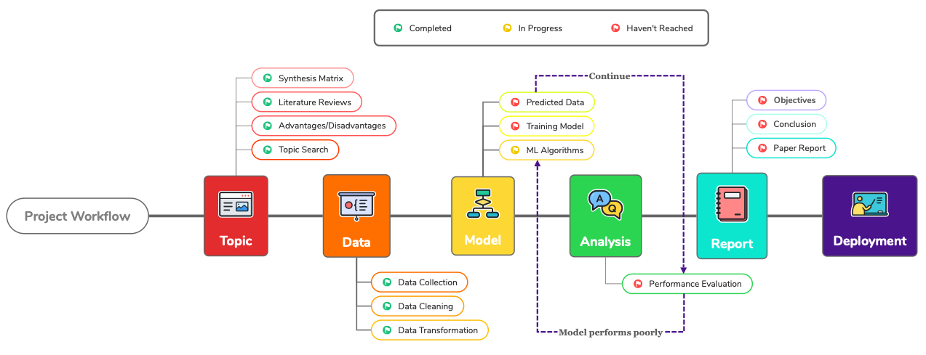
WK06 – Project Workflow Update

Slide 62
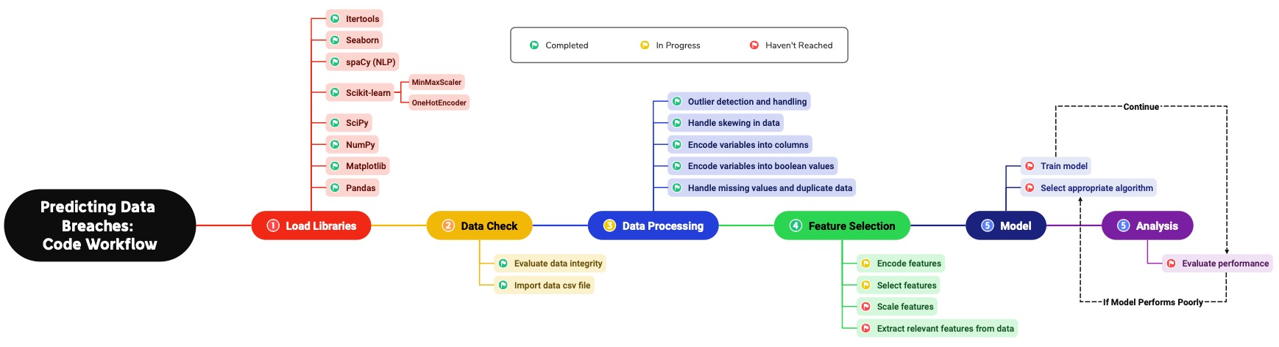
WK06 – Code Workflow Update

Slide 63
WK06 – Data Cleaning
Assumption Confirmed:
Every Boolean column with what seem to be null values are “No”.
If there are missing values in any other columns, they are the “true” null data.
Boolean columns with ”False” null data converted to “No”.
“” → “No”
These will later be turned into TRUE or FALSE
Rows with “True” Null Data were dropped to ensure data integrity using Pandas
Columns affected:
Breach Type Description
MA Residents Affected
Column with Date (Date Reported To OCA) converted to date-time using Pandas
8/9/2007 → 2007-08-09

Slide 64
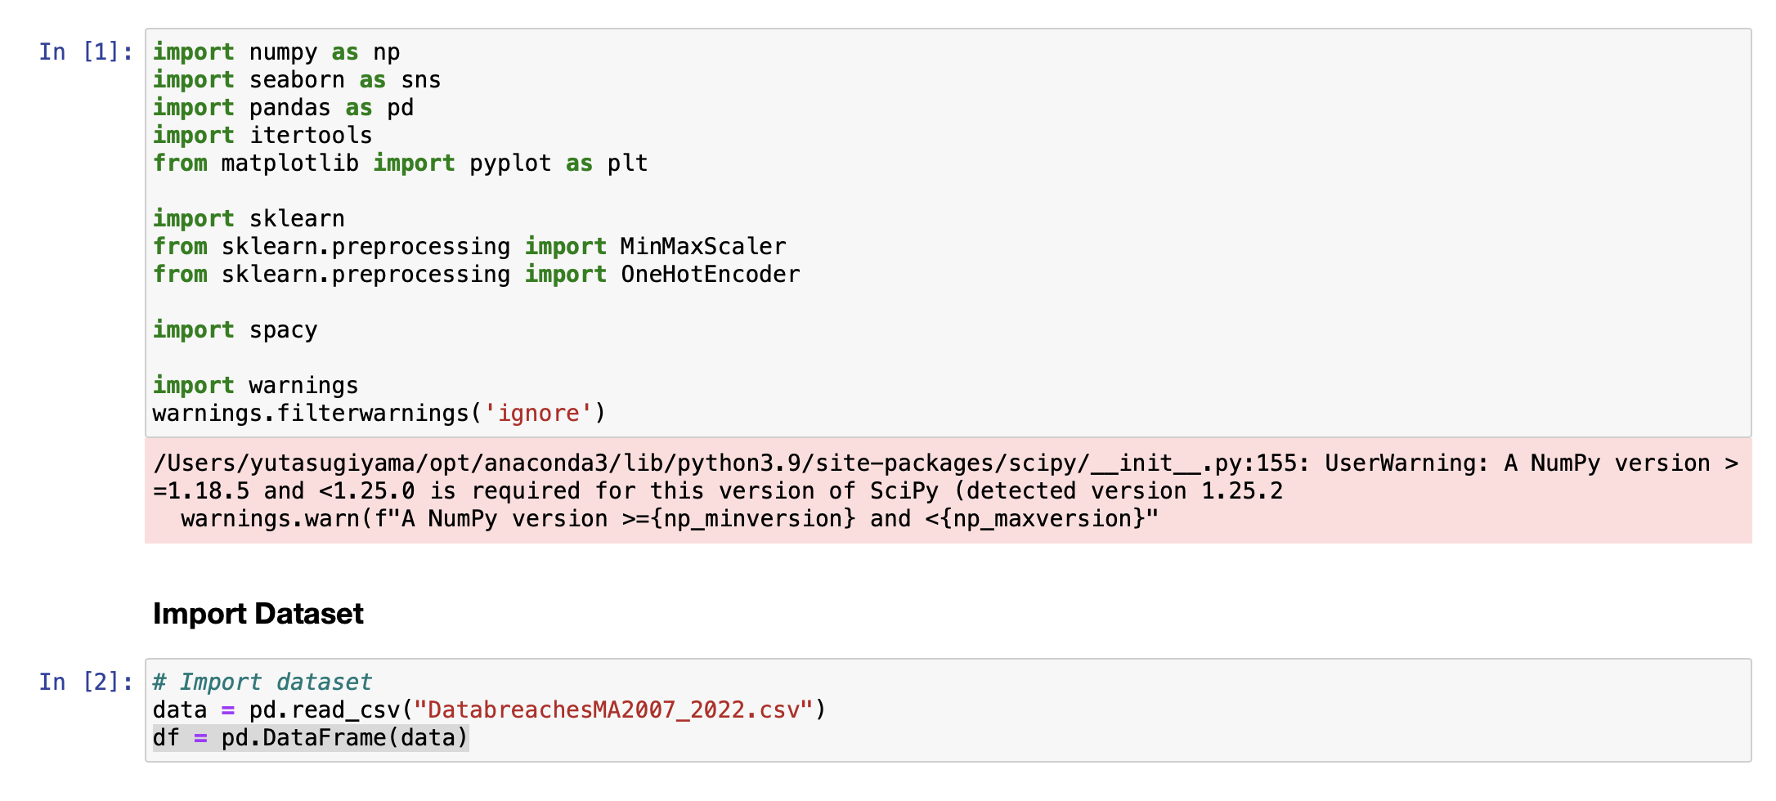
WK06 – Coding (Importing Libraries and Data)

Slide 65
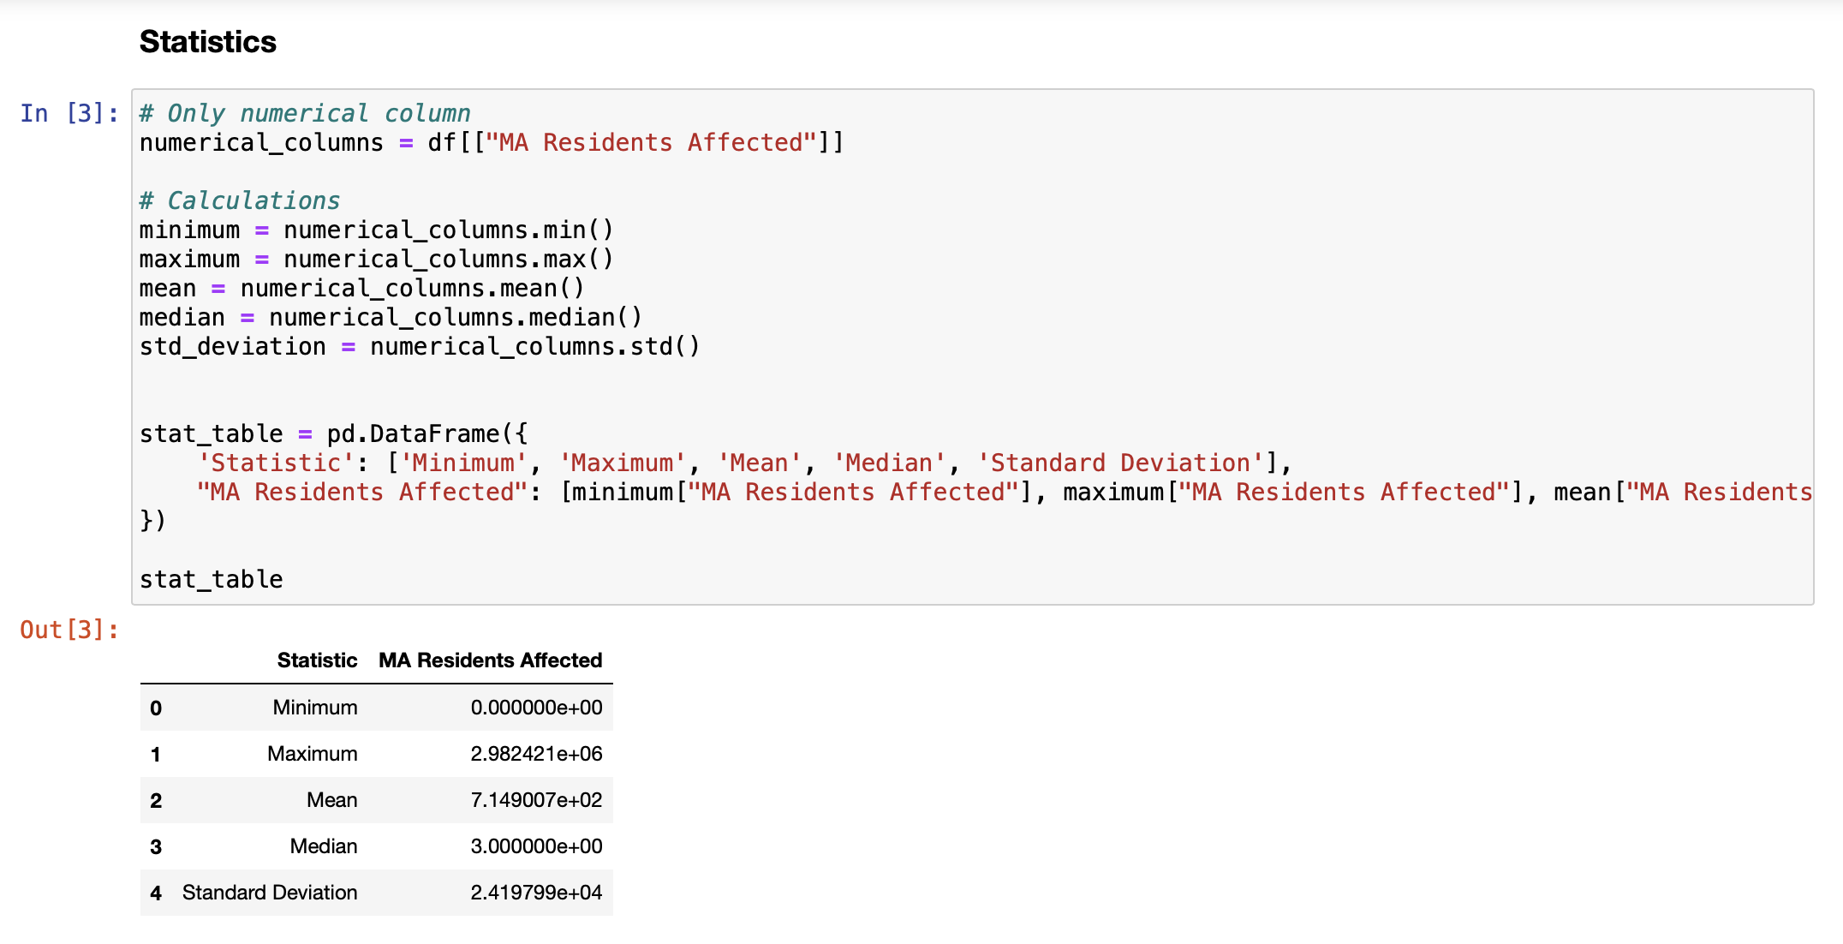
WK06 – Coding (Statistics Before Cleaning)

Slide 66
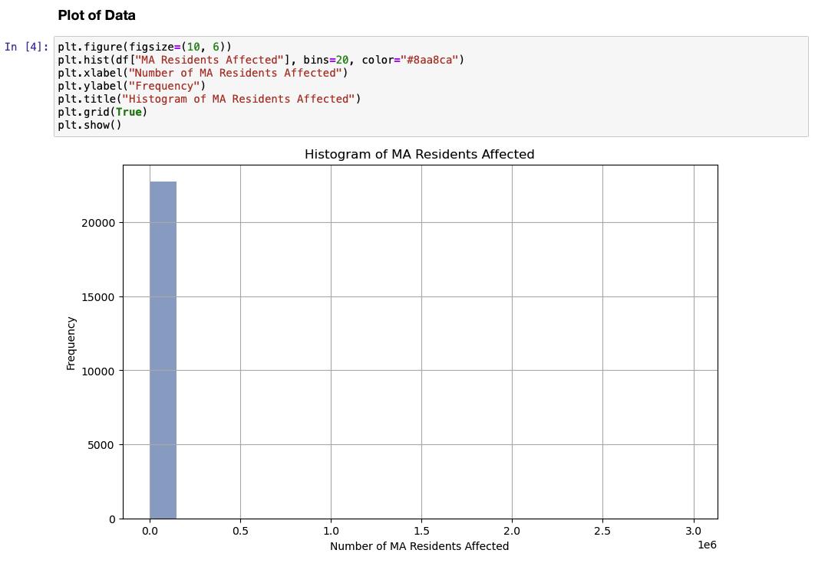
WK06 – Coding (Plot of Numerical Column)

Slide 67
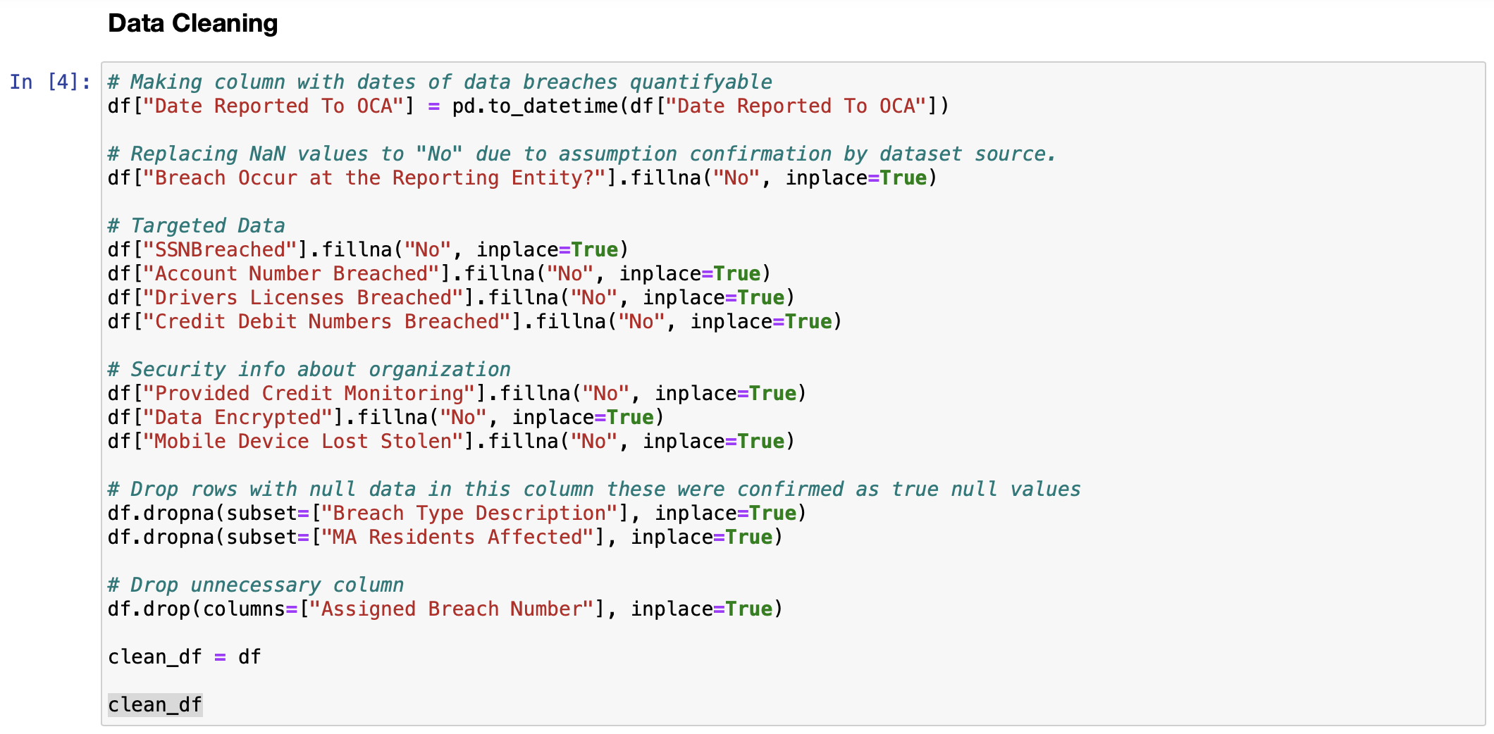
WK06 – Coding (Data Cleaning)

Slide 68
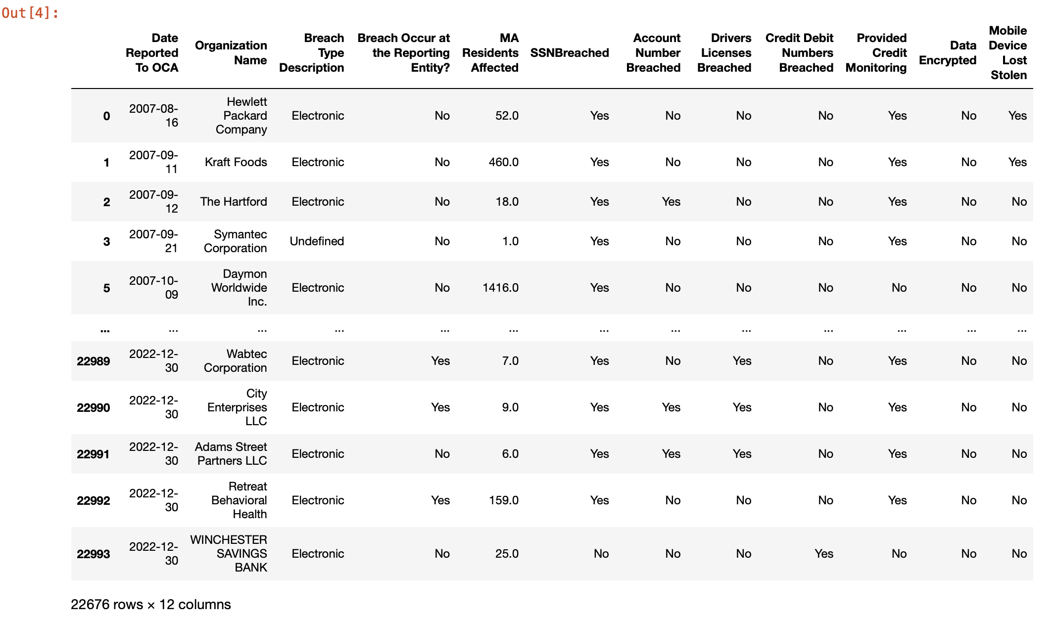
WK06 – Coding (Data Cleaning Result)

Slide 69
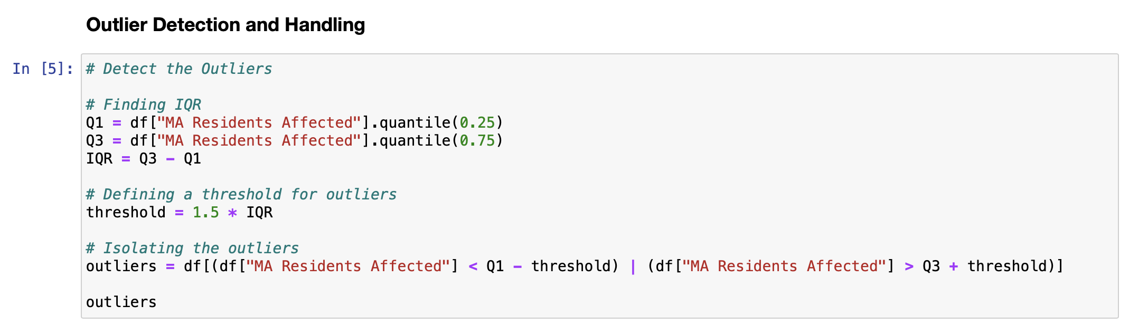
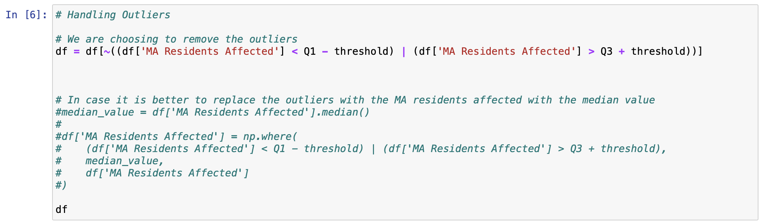
WK06 – Coding (Outlier Detection and Handling)

Slide 70
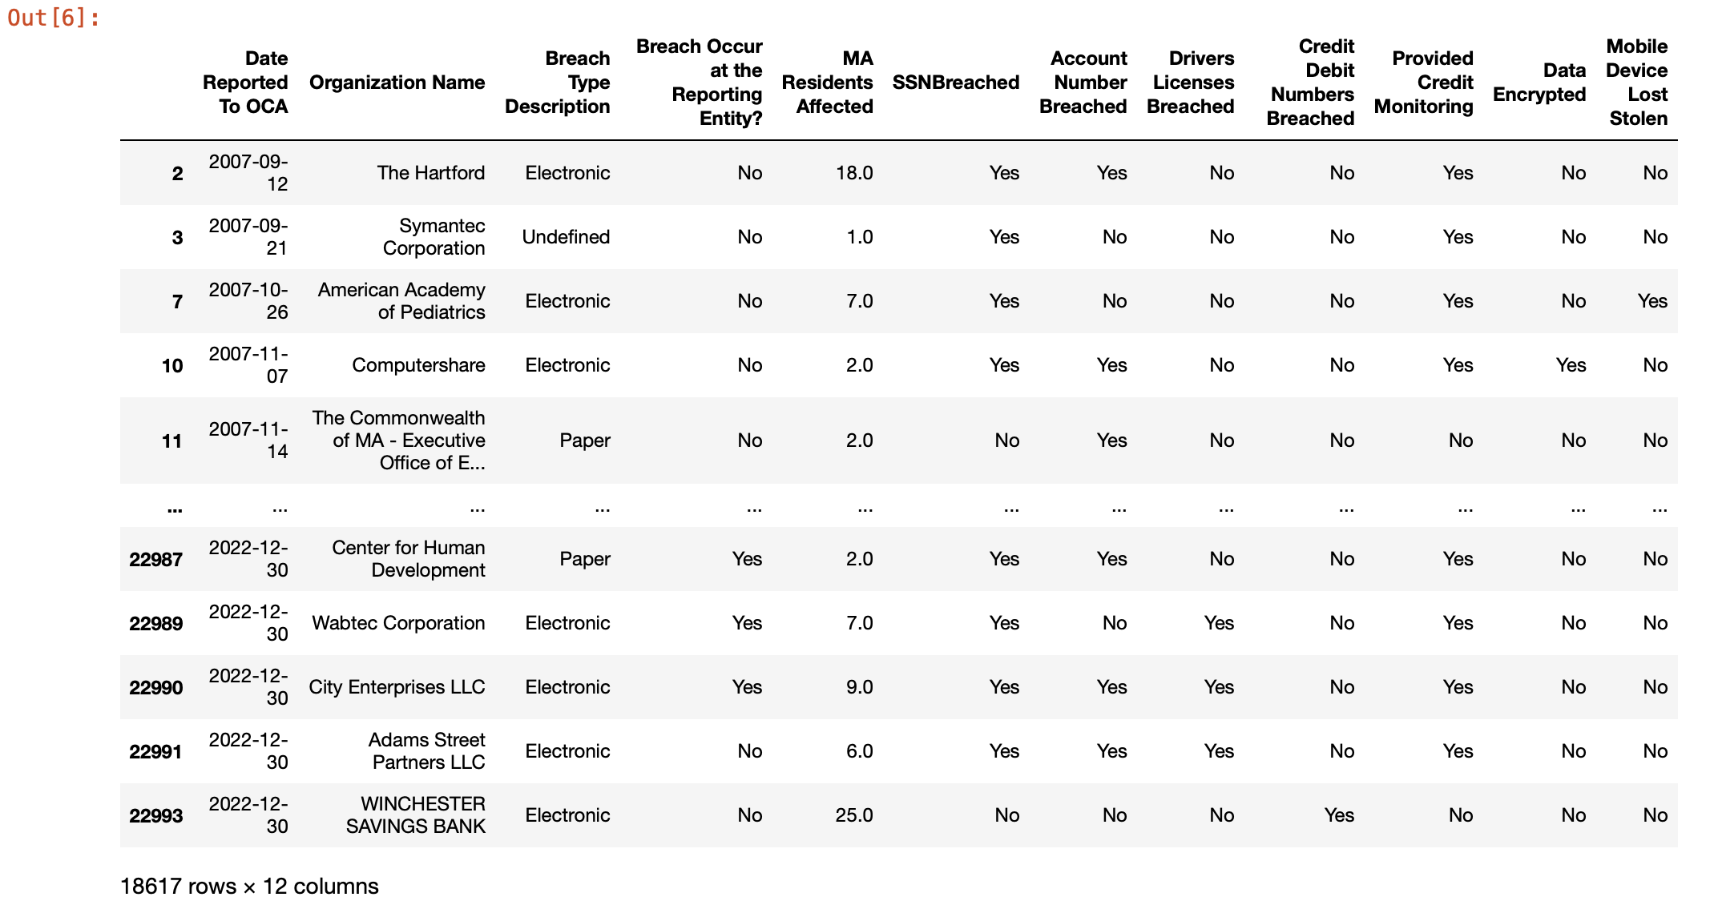
WK06 – Coding (Outlier Handling Result)

Slide 71
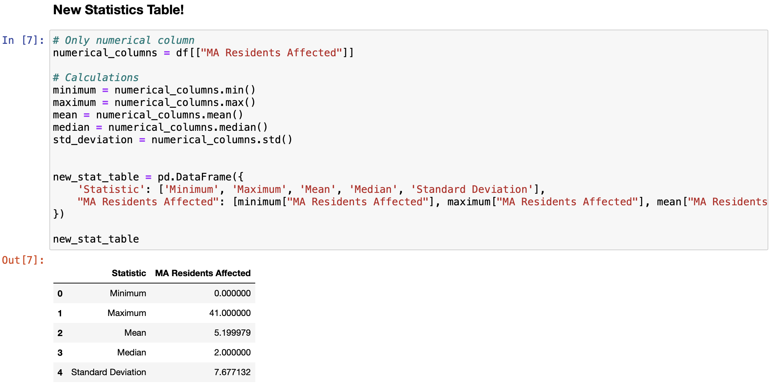
WK06 – Coding (New Statistics Table )

Slide 72
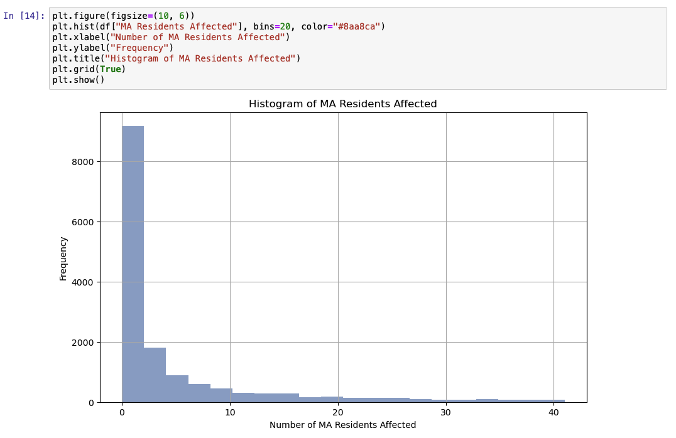
WK06 – Coding (New Plot of Numerical Column)

Slide 73
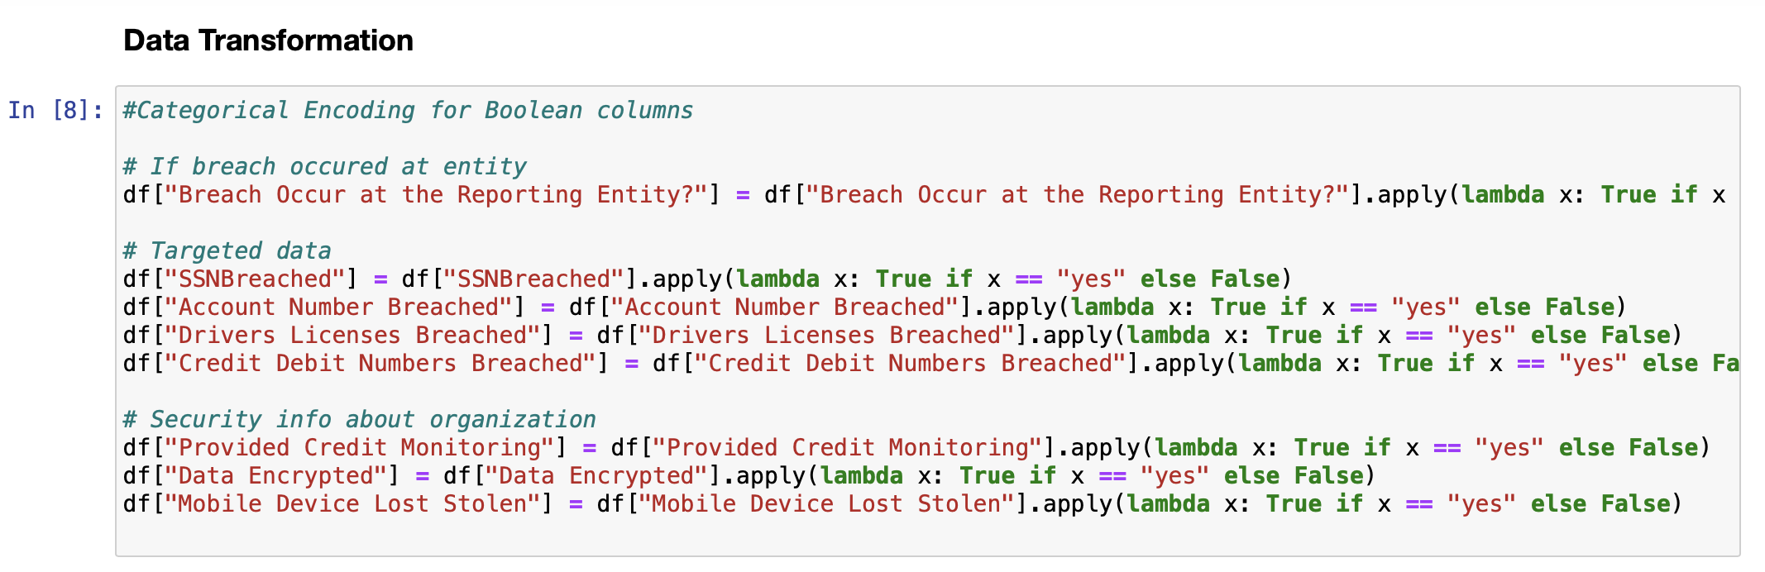
WK06 – Coding (Data Transformation)

Slide 74
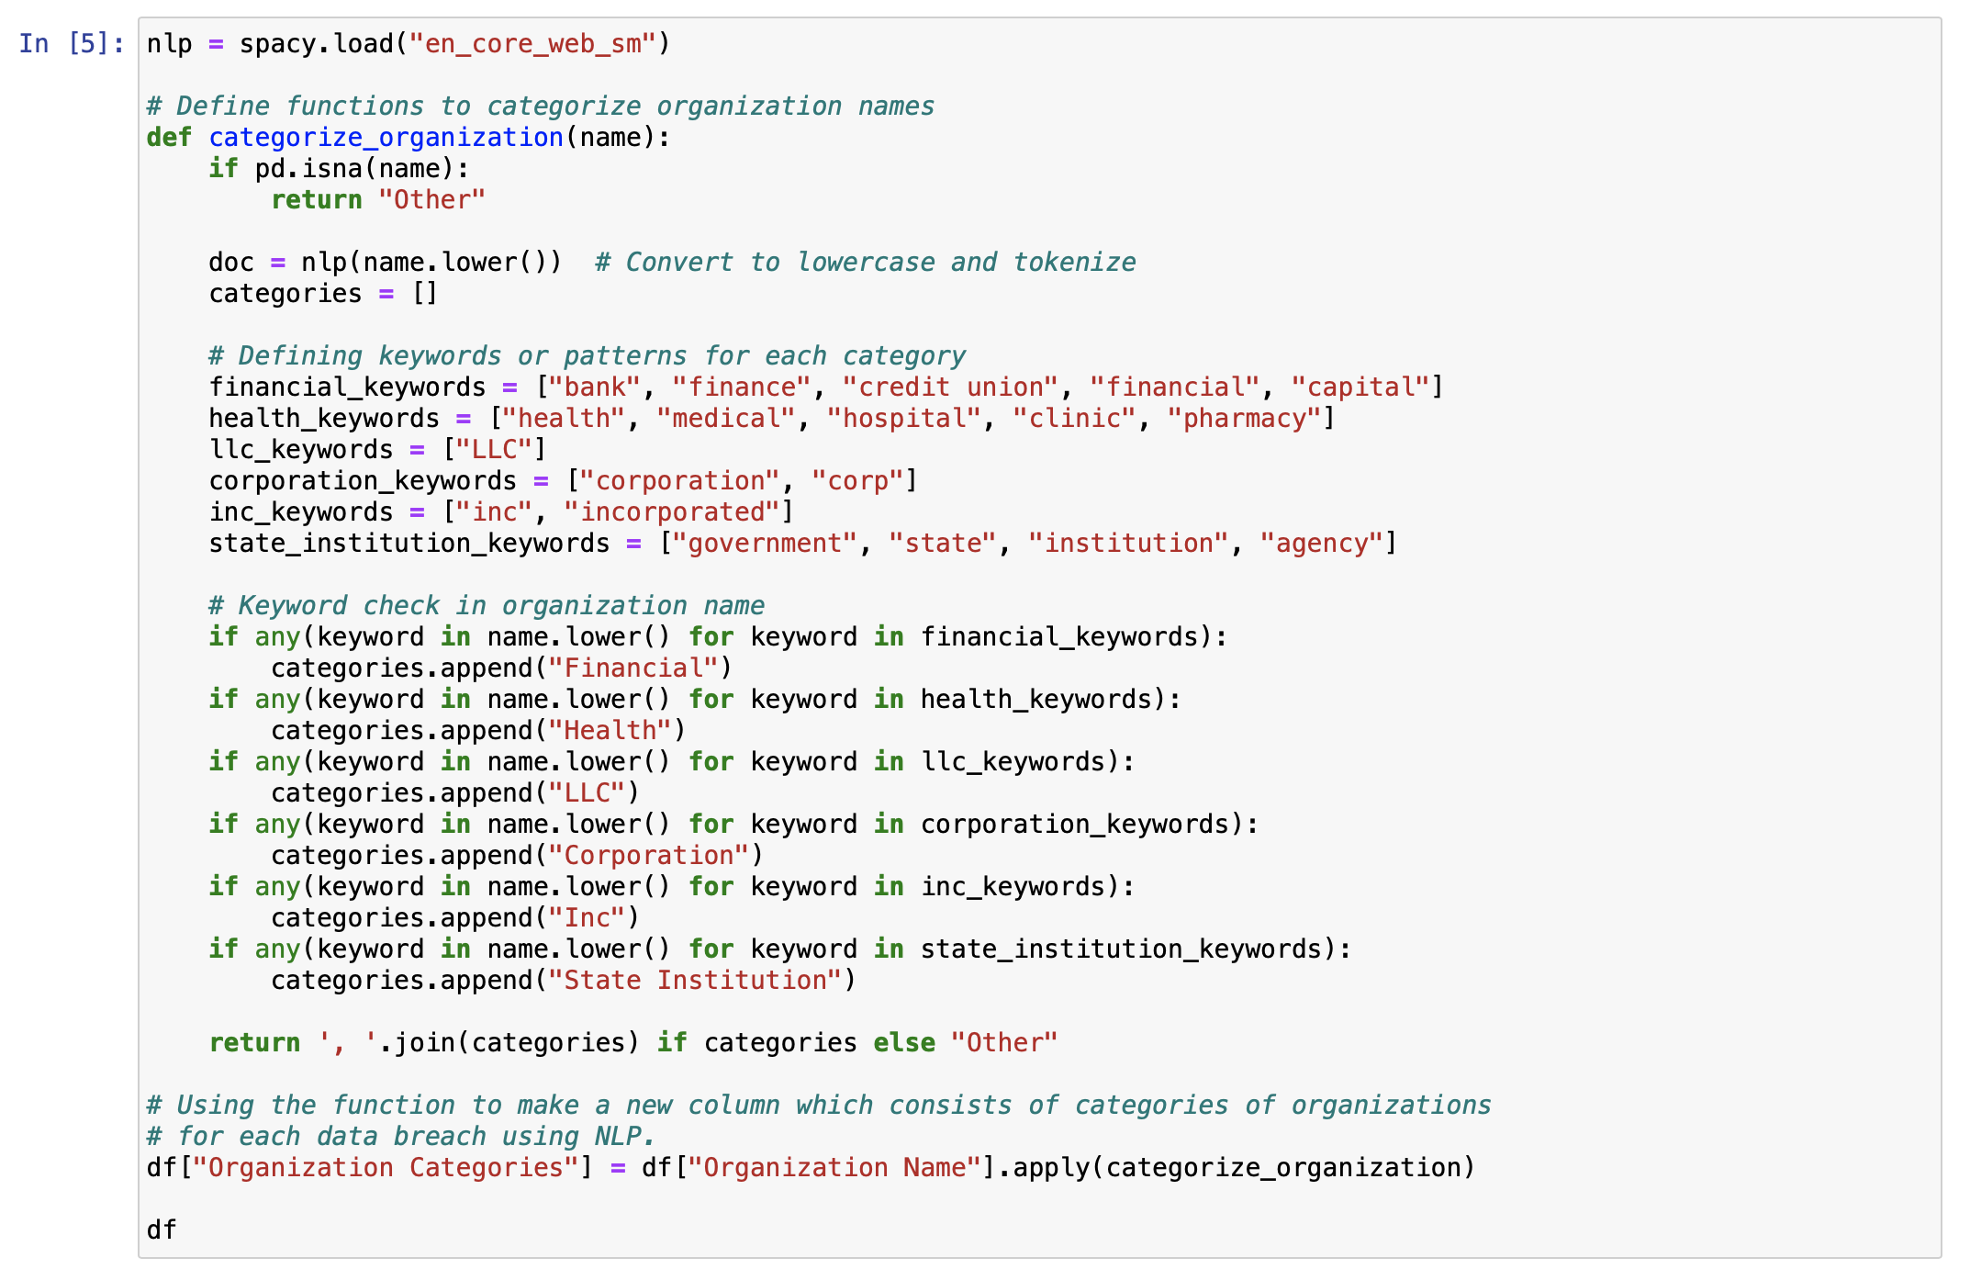
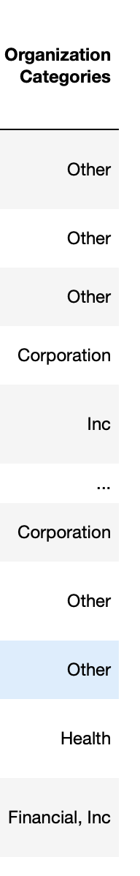
WK06 – Coding (Data Transformation)

Slide 75
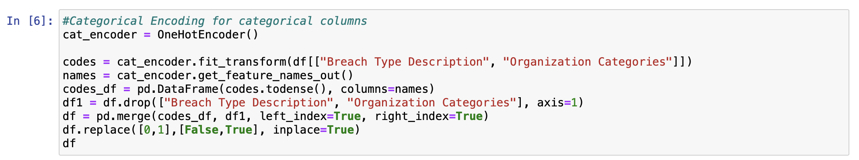
WK06 – Coding (Data Transformation)

Slide 76
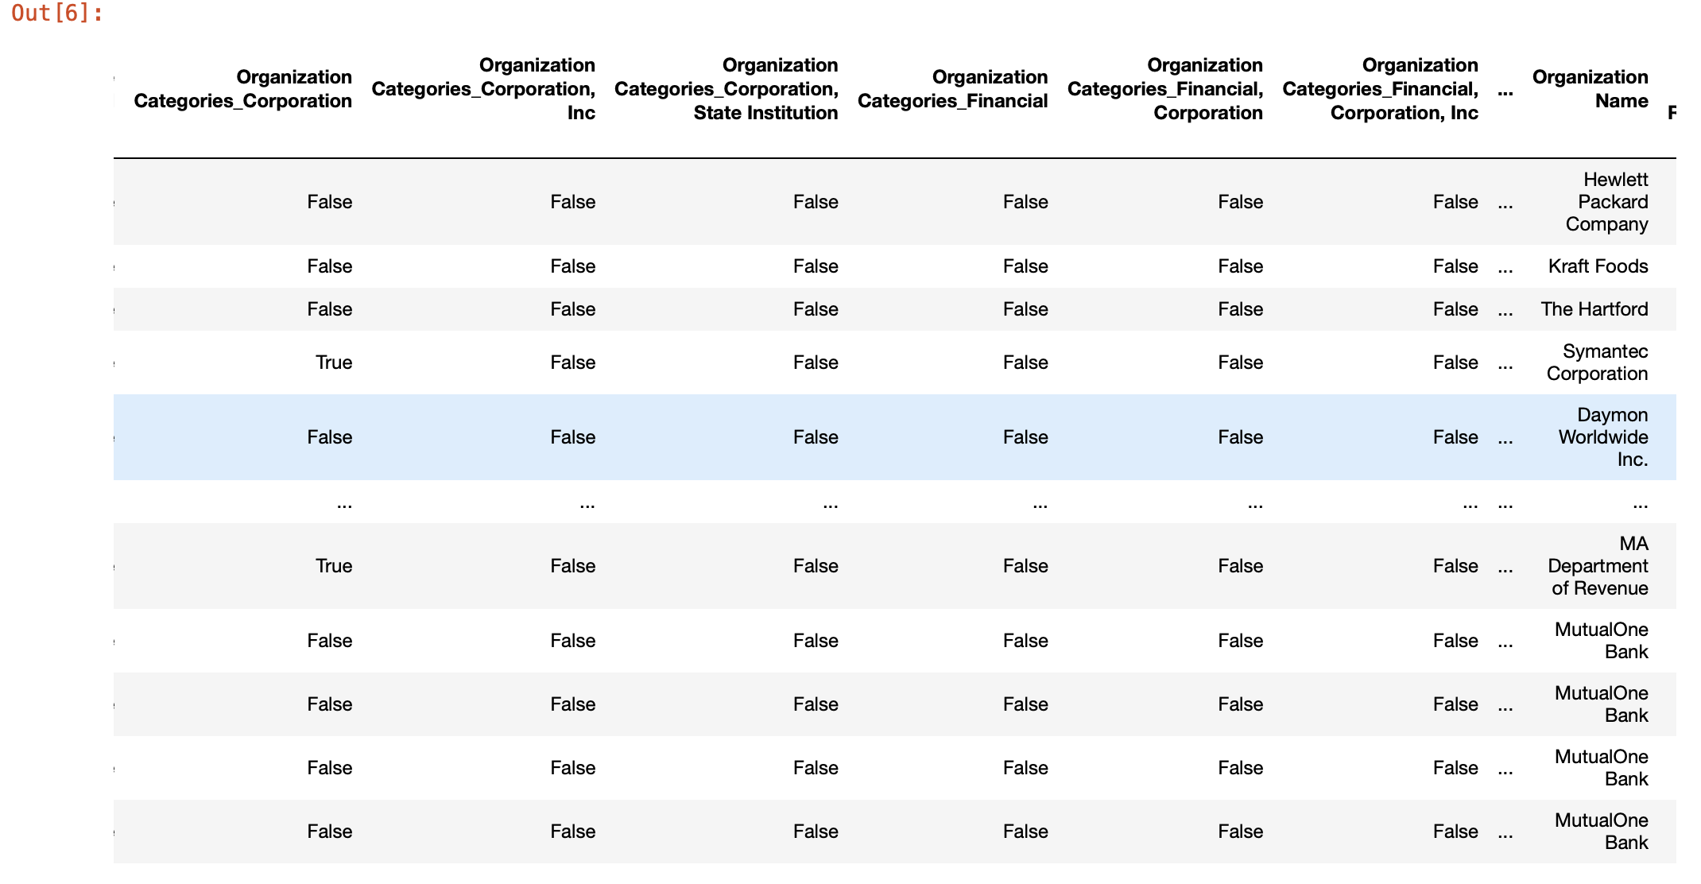
WK06 – Coding (Data Transformation)

Slide 77
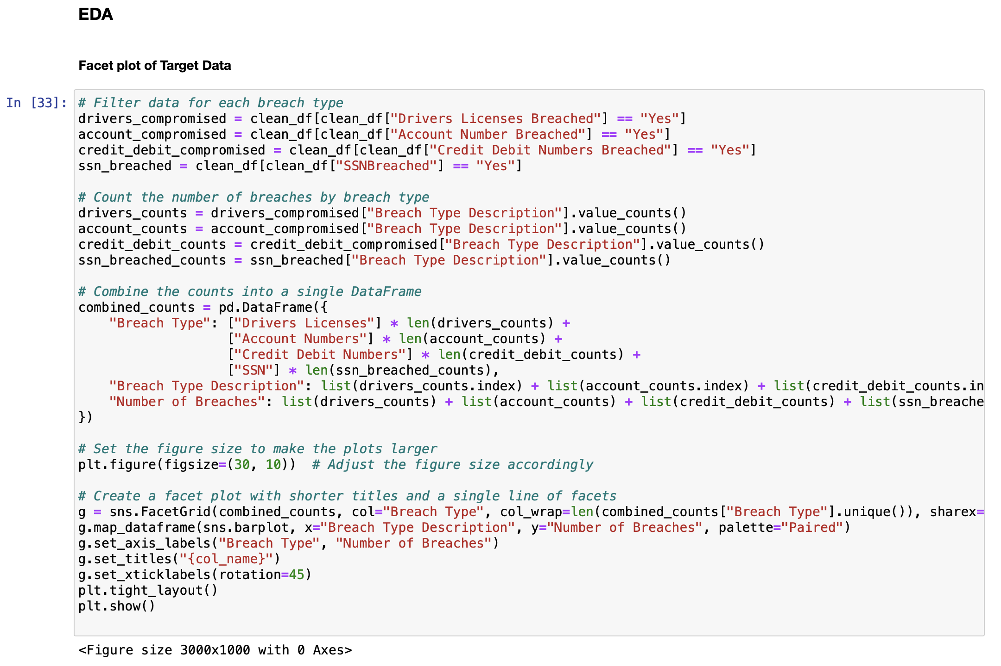
WK06 – Coding (EDA: Plot 1)

Slide 78
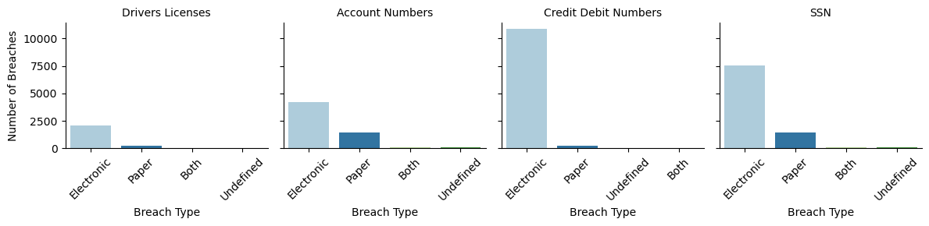
WK06 – Coding (EDA: Plot 1)

Slide 79
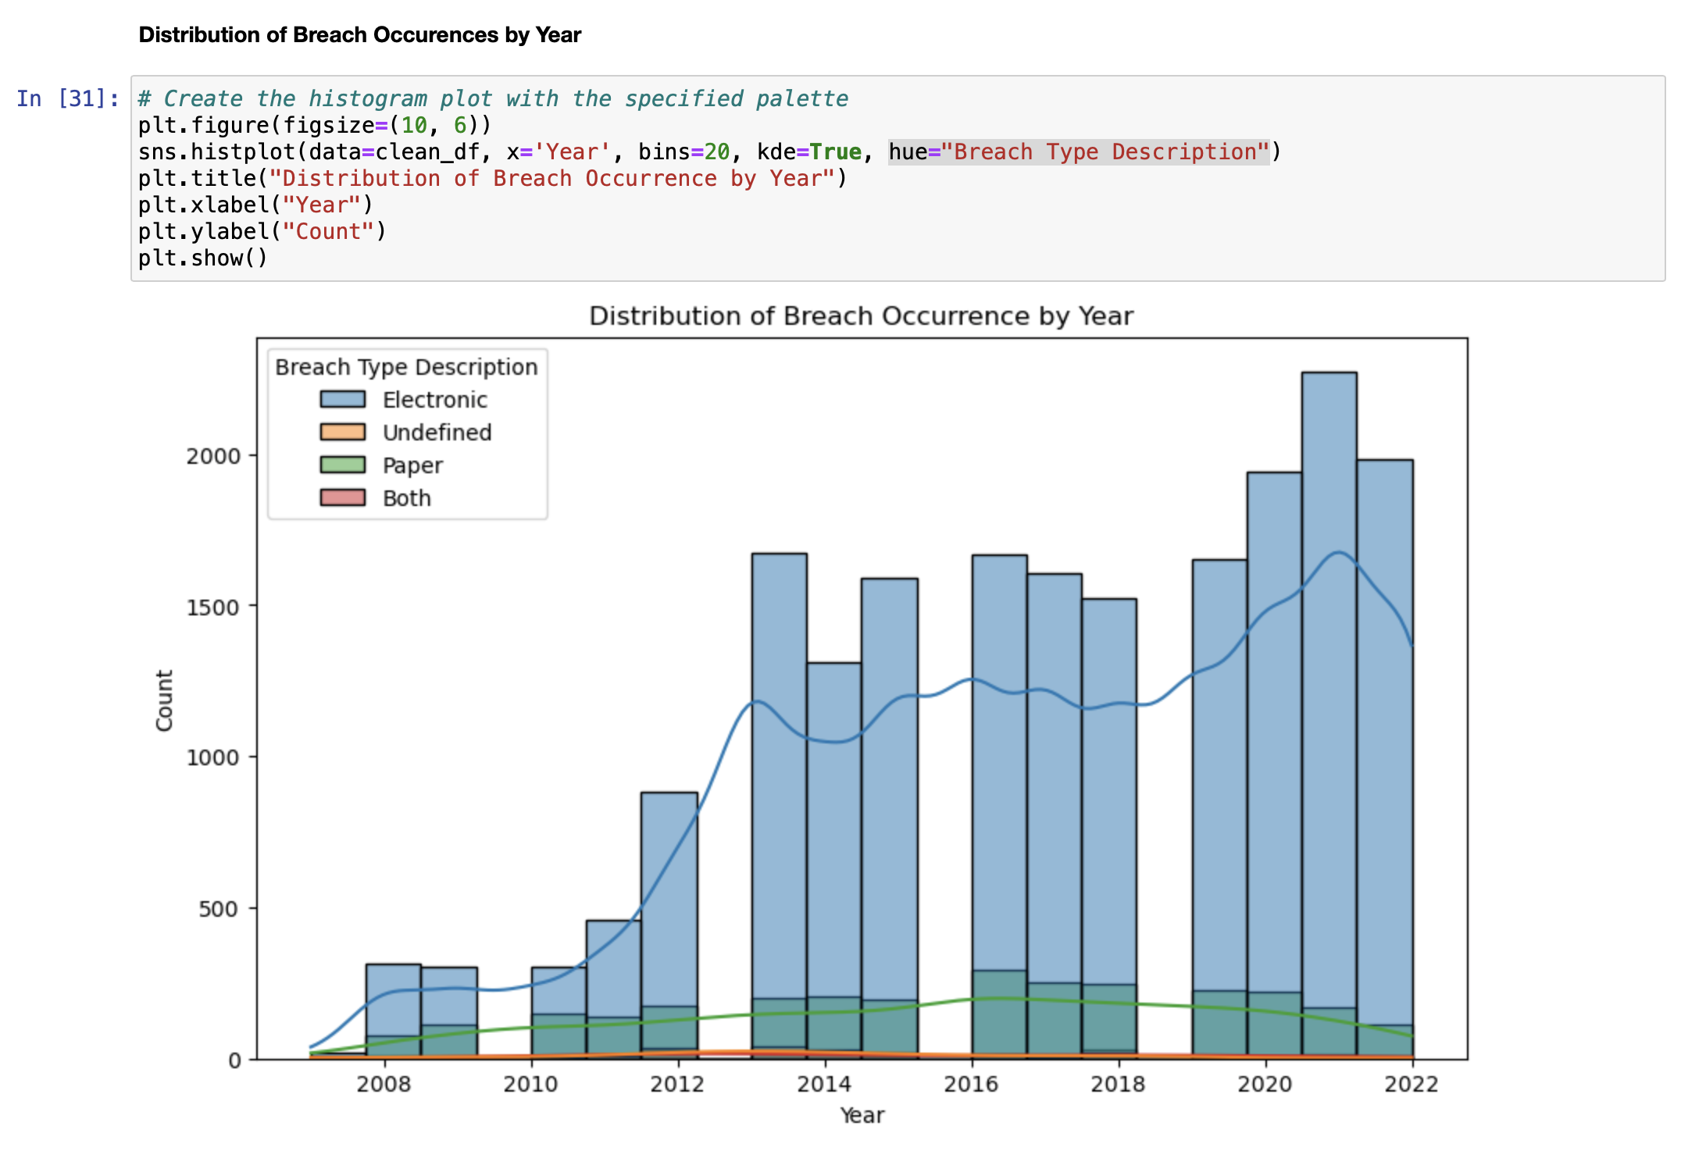
WK06 – Coding (EDA: Plot 2)

Slide 80
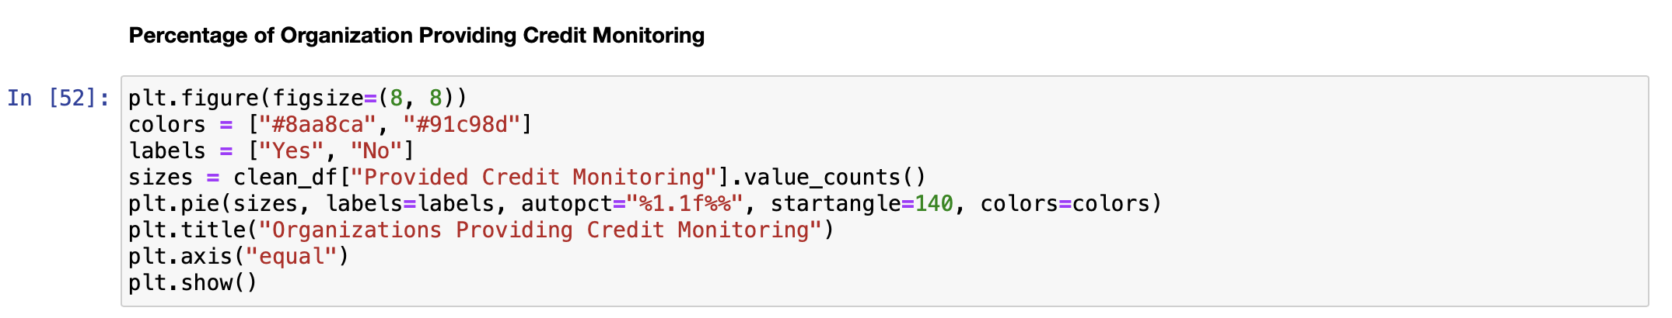
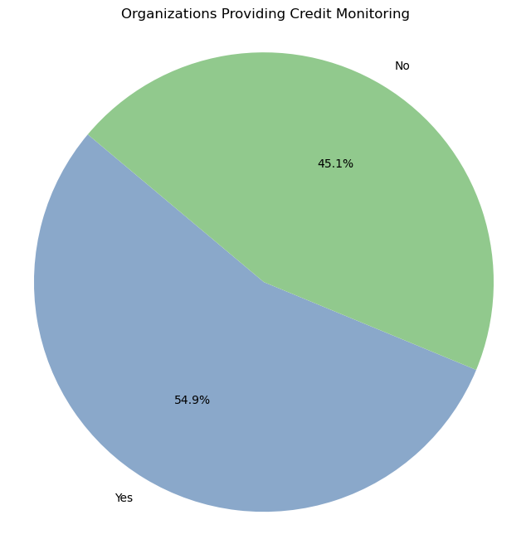
WK06 – Coding (EDA: Plot 3)

Slide 81
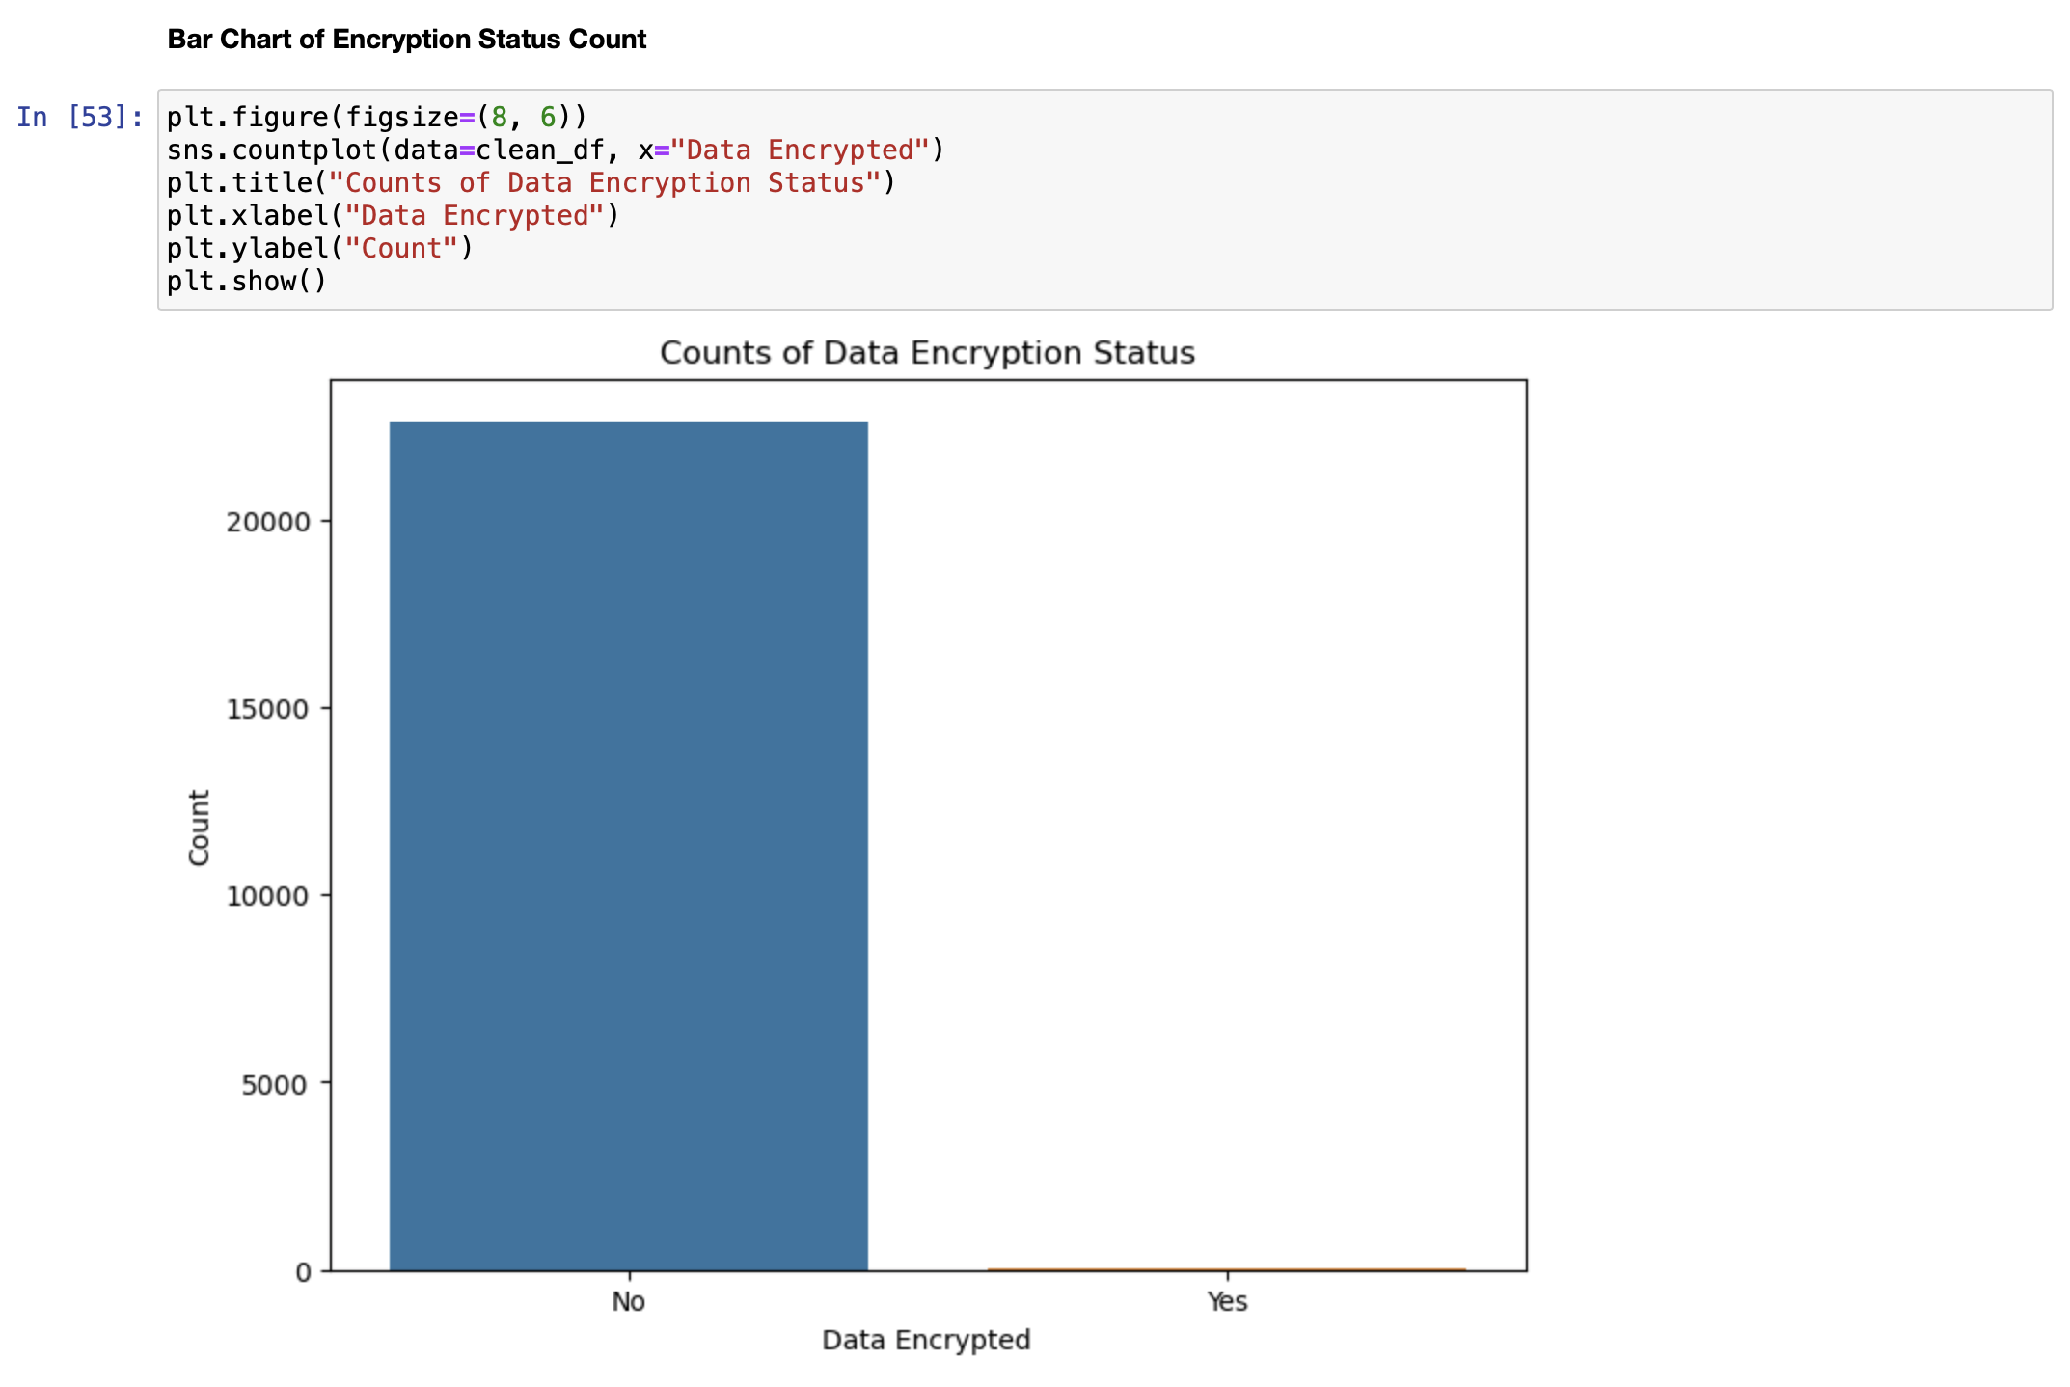
WK06 – Coding (EDA: Plot 4)

Slide 82
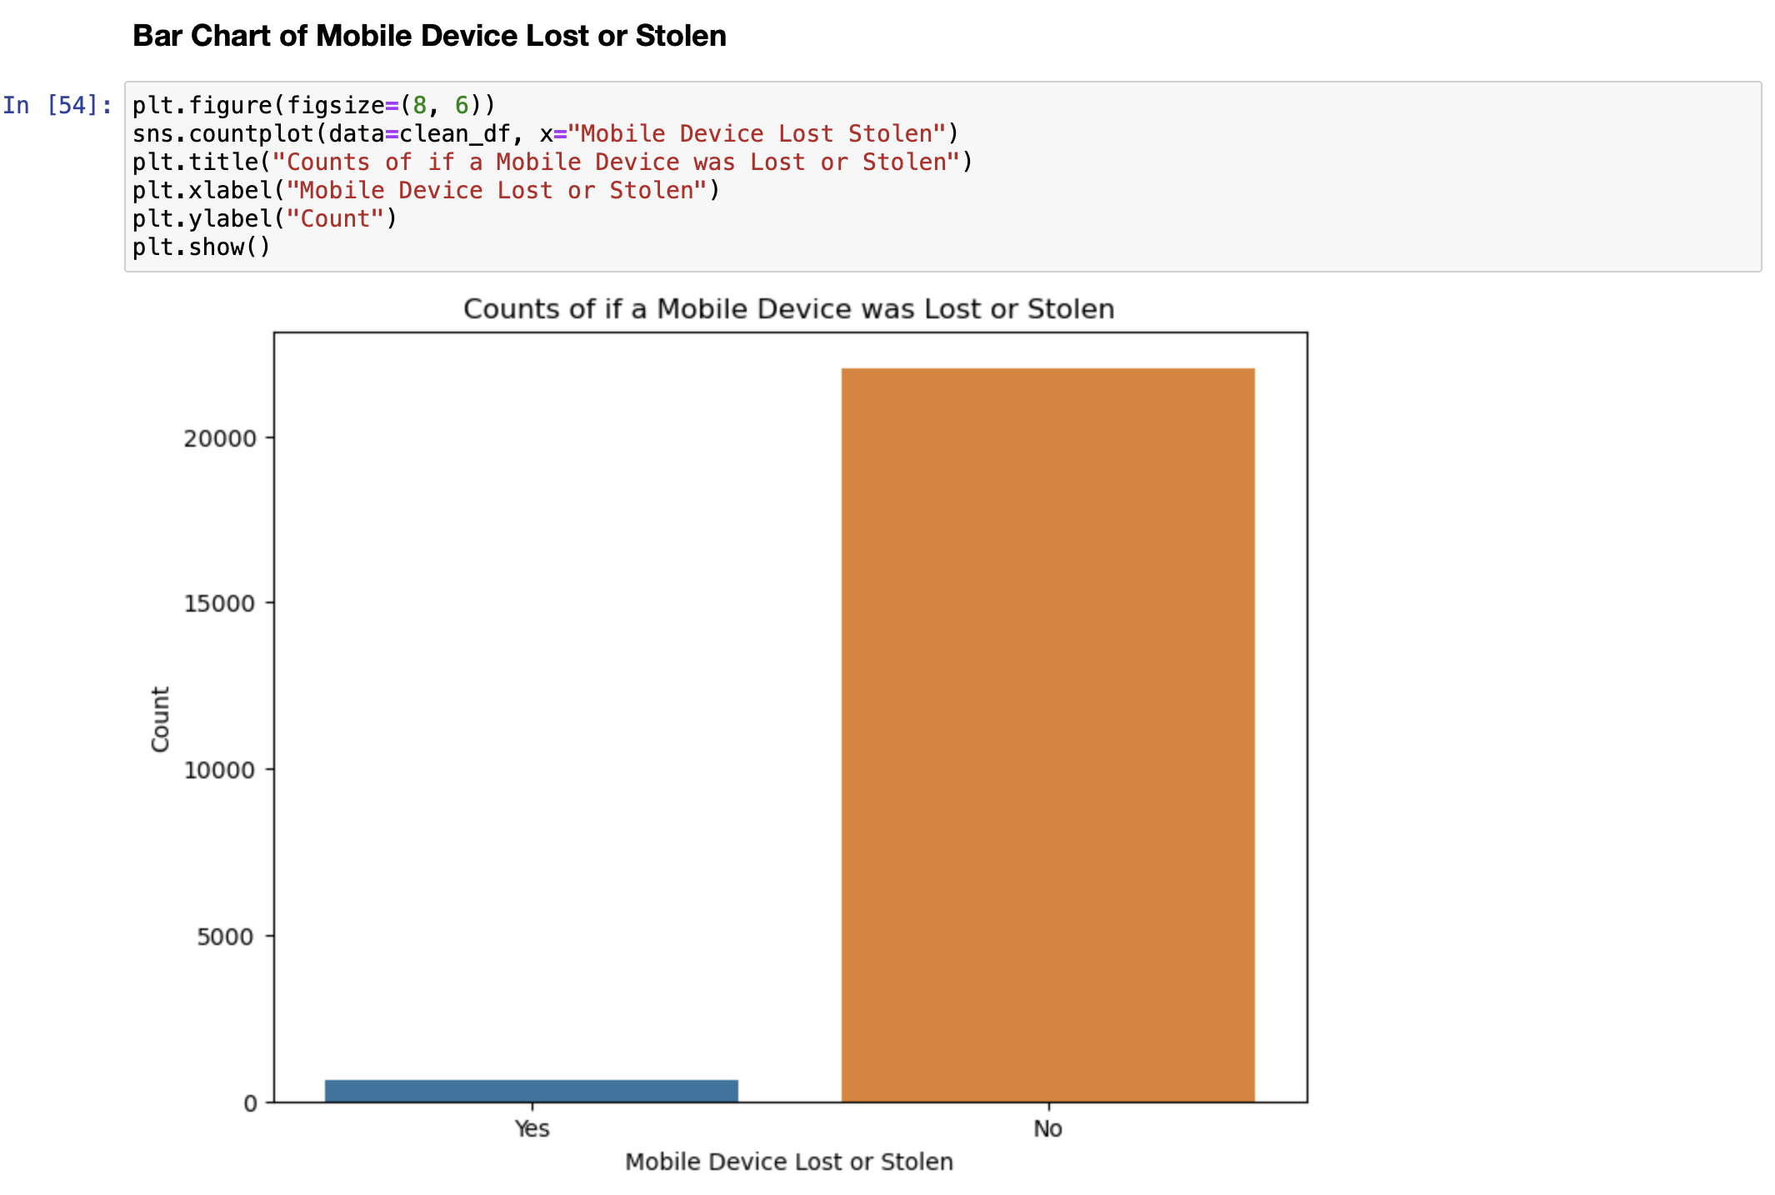
WK06 – Coding (EDA: Plot 5)

Slide 83
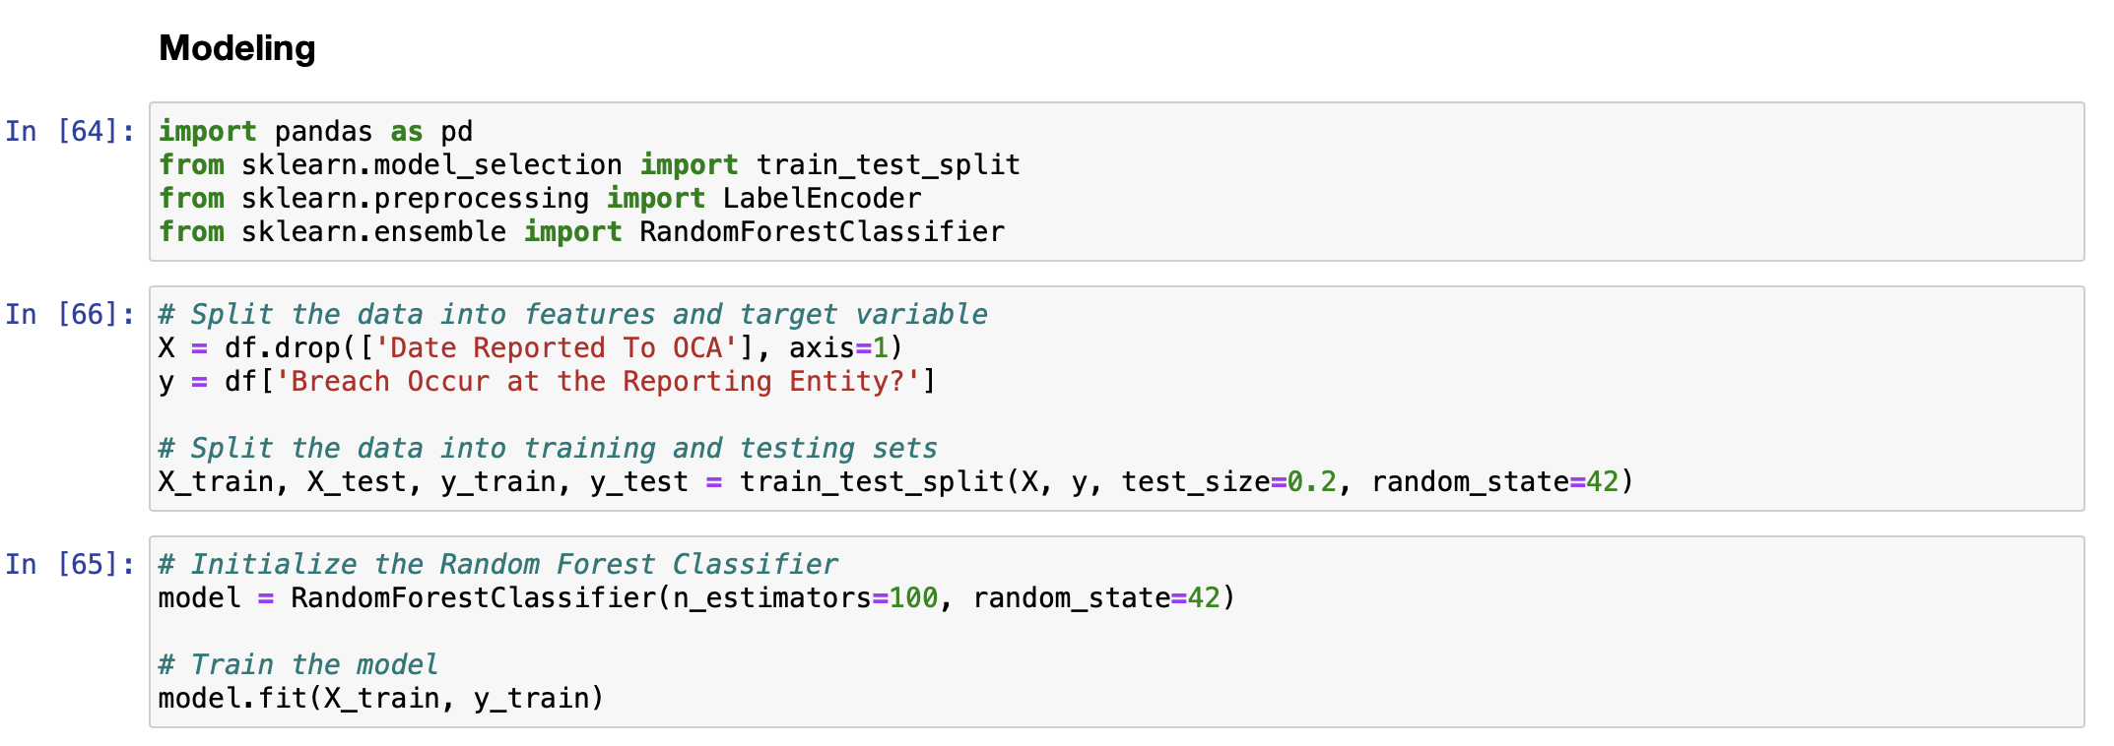
WK06 – Coding (Modeling: WIP Random Forest)

Slide 84
WK06 – Survey
I always seek to improve the class environment and productivity. Please help by answering the following questions. Be specific as much as possible: (use more than one slide if needed)
What would you propose that we should start doing in this class
Start the class with talking about interesting projects we saw online relevant to data science
Talking about a little more about each other (hobbies, our week, weekend, etc.) in the start of class.
Keep things chill and flowing ☺
What would you propose that we should stop doing in this class
Although we have a few people in our class, I feel like conversations that move too far away from relevant class topic should be kept a minimum when going through slides.
What would you propose that we should continue doing in this class
Keep asking questions or making recommendations for each other’s projects
Ending class with introducing something interesting (ending on an interesting note)
Workflow diagrams
Updates on revisions

Slide 85
Week - 08

Slide 86
WK08 – Review/revise work from previous week(s)
Below is a summary of changes made and slide numbers
Changed EDA plots and other plots
Log scaling for easier visualization
Adding Percentages to represent data more visually

Slide 87
WK08 – What was done for this week
Below is a summary of what was done this week
More NLP categories for data transformation process
Outlier Handling and Detection Review (Finding out how it affects the model)

Slide 88

WK08 – Project Workflow Update

Slide 89

WK08 – Code Workflow Update

Slide 90
WK08 – Additional Work Done on Data Cleaning
No additional work on data cleaning from WK06
Made 3 separate cleaned datasets for the 3 models
Plans to optimize the outlier handling and detection after looking at the results of 3 Models.

Slide 91
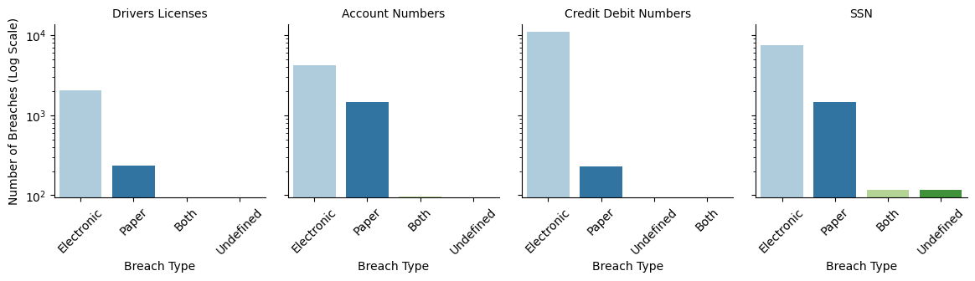
WK08 – Additional Work Done on Data Exploration
Changed EDA plots and other plots
Log scaling for easier visualization
Adding Percentages to represent data more visually for Plot 4 and 5

Slide 92
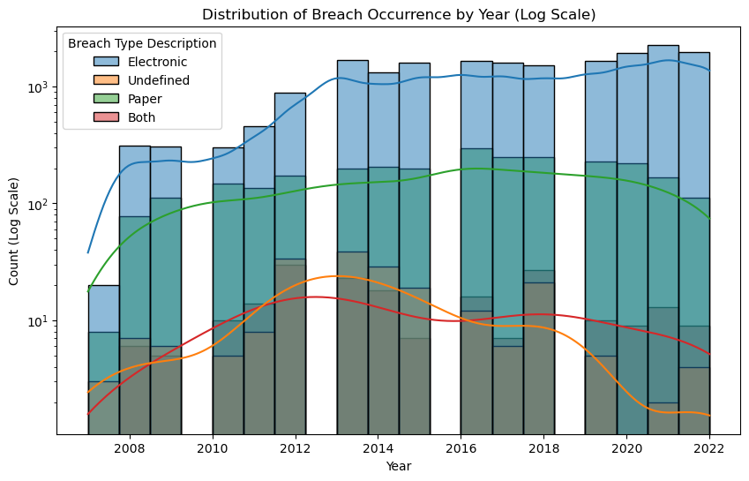
WK08 – Additional Work Done on Data Exploration

Slide 93
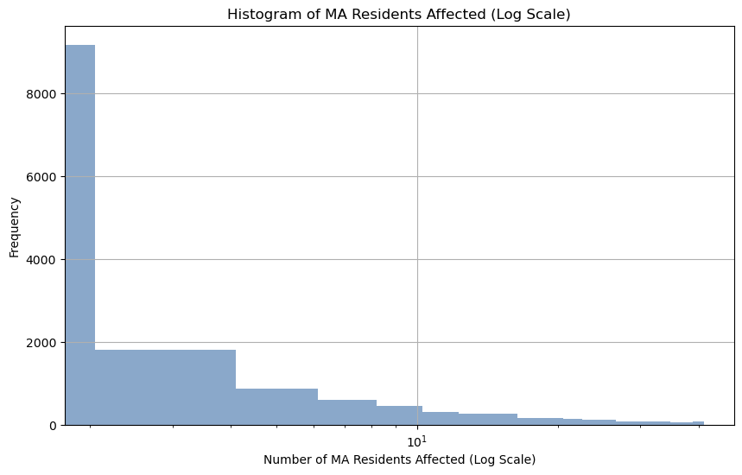
WK08 – Additional Work Done on Data Exploration

Slide 94
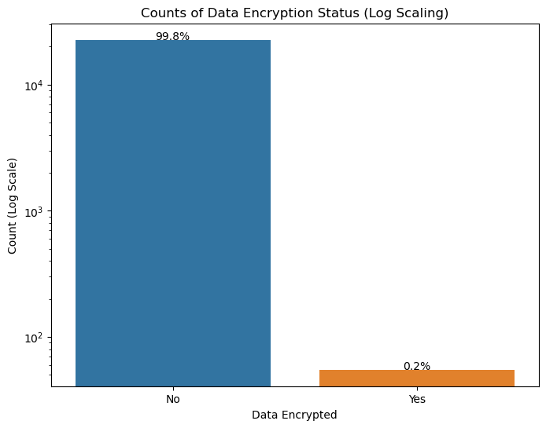
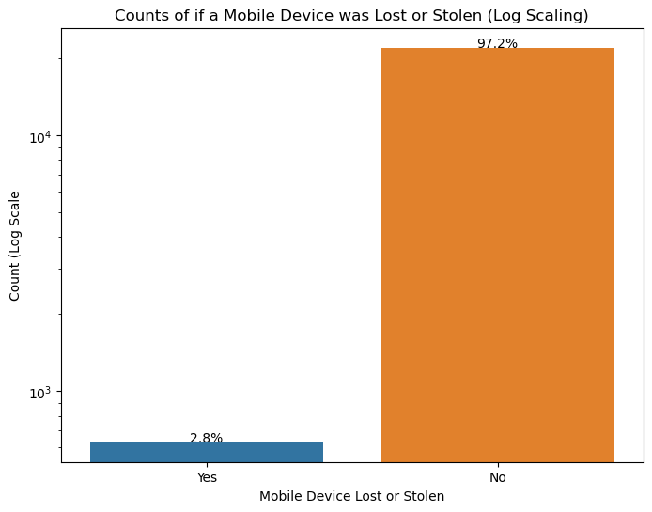
WK08 – Additional Work Done on Data Exploration

Slide 95
WK08 – Model 1
What algorithm(s) are you using
Logistic Regression
What settings are you using to train and test your algorithm(s)
Training and testing data are split with a test set of 20% and training set of 80%
Random state is 50.
What does my code model
This model uses logistic regression to predict the likelihood of data breaches occurring at the reporting entity based on various features, including breach type, organization categories, and all binary variables. The model is evaluated on the testing data using metrics: accuracy, precision, recall, F1-score, ROC-AUC, and a classification report.
What do you expect to get at the output
I expect a good accuracy score, a reasonable precision score, a good recall score, a balanced F1-score, and a high ROC-AUC score.
What output are you getting
Accuracy: The model achieved an accuracy of 0.80, which means it correctly predicted data breaches in 80% of cases.
Precision: The precision score is 0.67, indicating that among the predicted positive cases, 67% are true positives.
Recall: The recall score is 0.72, meaning that the model correctly identifies 72% of the actual positive cases.
F1-Score: The F1-score is 0.70, providing a balanced measure of precision and recall.
ROC-AUC: The ROC-AUC score is 0.88, which suggests the model's ability to distinguish between positive and negative cases is quite high.

Slide 96
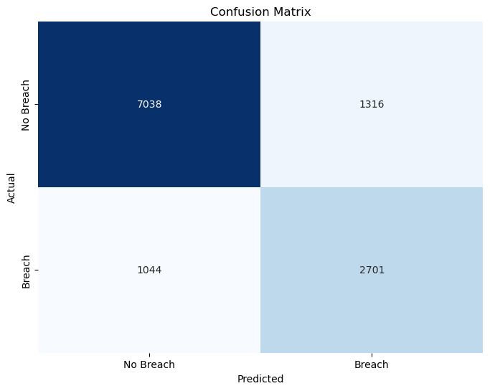
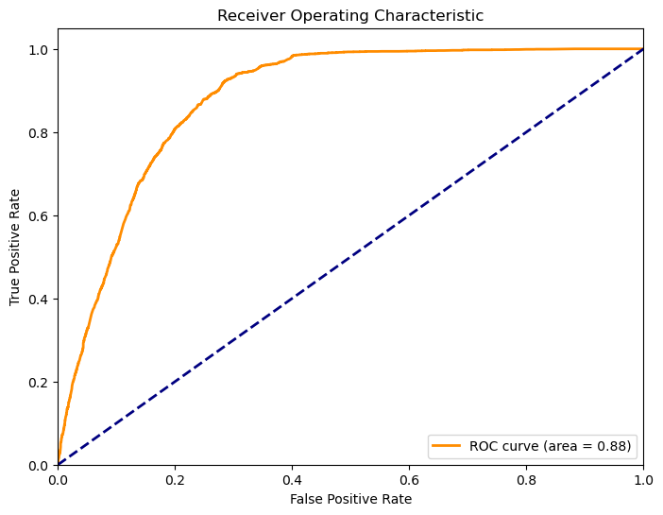
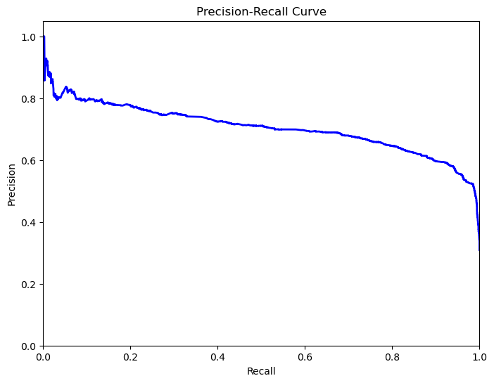
WK08 – Results of the algorithm (Model 1)
Show graphs to explain the output of your algorithm

Slide 97
WK08 – Results of the algorithm (Model 1)
Explain the values obtained for the performance measures (e.g., correlation, accuracy, F-test)
Accuracy: Accuracy measures the overall correctness of predictions. An accuracy of 0.8 suggests that the model correctly predicts data breaches in 80% of cases.
Precision: Precision quantifies the model's ability to correctly classify data breaches when it makes positive predictions. A precision of 0.67 indicates that 67% of the positive predictions were correct.
Recall: Recall evaluates the model's capability to identify data breaches among the actual positive cases. A recall of 0.72 means that 72% of actual data breaches were correctly identified.
F1-Score: The F1-score is the harmonic mean of precision and recall. An F1-score of 0.70 represents a balance between precision and recall.
ROC-AUC: The ROC-AUC score of 0.88 is high, indicating that the model is effective at distinguishing between positive and negative cases. It quantifies the model's ability to rank instances correctly.
Explain the results
Model 1 has a good ability to designate between data breach and non-data breach cases. Although, there is room for improvement in precision and recall, because the model has some false positives and misses some actual data breach cases.

Slide 98
WK08 – Results of the algorithm (Model 1)
Graph the results

Slide 99
WK08 – Results of the algorithm (Model 1)
How would you improve the results
Data has some imbalance, so techniques like oversampling, undersampling, or synthetic data generation can assist in the class imbalance.
Check for any algorithmic biases
What more changes do you need to make to your code or data
A more focused feature selection
Now I have the model results, I can designate how to deal with the outlier handling and detection.

Slide 100
WK08 – Model 2
What algorithm(s) are you using
Random Forest
What settings are you using to train and test your algorithm(s)
Training and testing data are split with a test set of 20% and training set of 80%
Random State is at 50.
n_estimators is at 100.
What does your code model
This model uses a random forest classifier to predict whether data breaches are "organized" based on a Boolean operation of selected features. It aims to provide a binary classification of data breaches to understand the factors influencing their occurrence. It calculates accuracy, precision, recall, F1-score, and ROC-AUC, a classification report, and a confusion matrix to evaluate performance.
What do you expect to get at the output
I expect a good accuracy score, a high precision, recall, F1-score, a clear distinction between true positive and true negative predictions in the confusion matrix.
What output are you getting
Accuracy: The model achieves an accuracy of approximately 84.92%, which is a reasonably high accuracy score.
Classification Report: The classification report shows high precision, recall, and F1-score for the class '1' (data breaches). However, for class '0' (non-data breaches), precision, recall, and F1-score are all 0.00.
Confusion Matrix: The confusion matrix indicates that the model correctly identifies all 'Organized' cases (data breaches) but does not recognize any 'Not Organized' cases (non-data breaches).

Slide 101
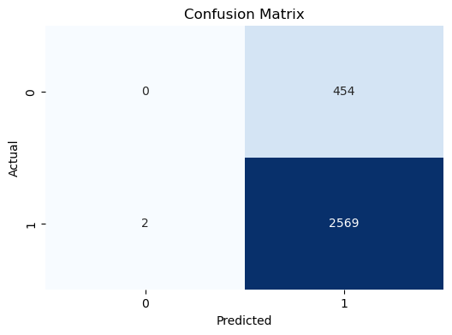
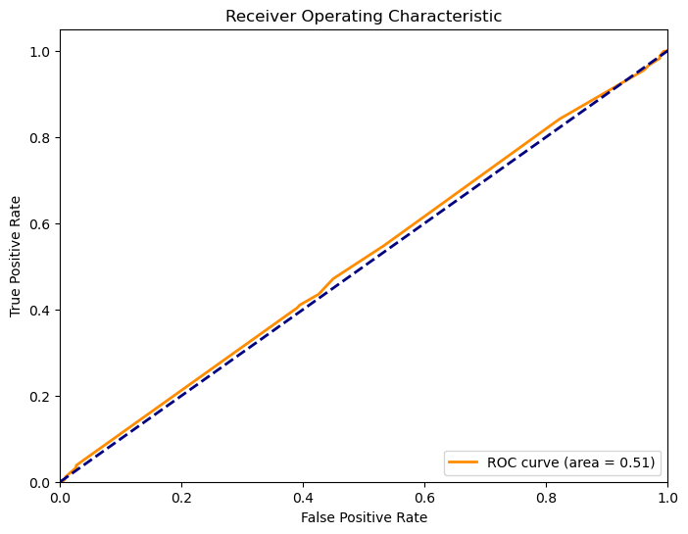
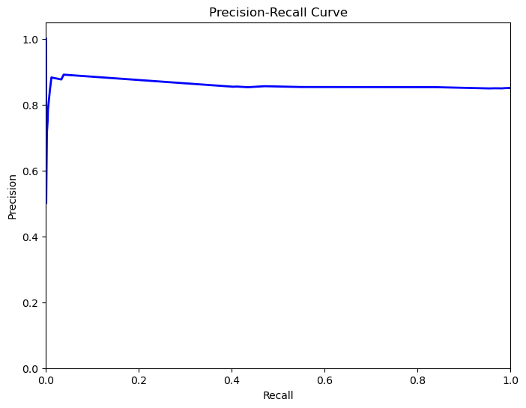
WK08 – Results of the algorithm (Model 2)
Show graphs to explain the output of your algorithm

Slide 102
WK08 – Results of the algorithm (Model 2)
Explain the values obtained for the performance measures (e.g., correlation, accuracy, F-test)
Accuracy: The model achieves an accuracy of approximately 84.92%, which is a reasonably high accuracy score.
Classification Report: The classification report shows high precision, recall, and F1-score for the class '1' (data breaches). However, for class '0' (non-data breaches), precision, recall, and F1-score are all 0.00.
Confusion Matrix: The confusion matrix indicates that the model correctly identifies all 'Organized' cases (data breaches) but does not recognize any 'Not Organized' cases (non-data breaches).
Explain the results
Model 2’s performance is imbalanced, because it strongly favors correctly predicting data breaches but completely fails to identify non-data breaches.

Slide 103
WK08 – Results of the algorithm (Model 2)
Graph the results

Slide 104
WK08 – Results of the algorithm (Model 2)
How would you improve the results
Data has some imbalance, so techniques like oversampling, undersampling, or synthetic data generation can assist in the class imbalance.
Check for any algorithmic biases
What more changes do you need to make to your code or data
A more focused feature selection
Now I have the model results, I can designate how to deal with the outlier handling and detection.

Slide 105
WK08 – Model 3
What algorithm(s) are you using
Decision Tree
What settings are you using to train and test your algorithm(s)
Training and testing data are split with a test set of 20% and training set of 80%
Random State is at 50.
Max depth for the Decision Tree at 5.
The model is evaluated on the testing data using metrics: accuracy, precision, recall, F1-score, ROC-AUC, and a classification report.
What does your code model
This model uses a decision tree classifier to predict whether data breaches occur at the reporting entity. It also includes feature engineering by converting dates and one-hot encoding and visualizes the decision tree.
What do you expect to get at the output
I expect a good accuracy score, a reasonable precision score, a good recall score, a balanced F1-score, and a high ROC-AUC score.
What output are you getting
Accuracy: The model achieves an accuracy of approximately 90.38%, which is a high accuracy score.
Precision: The precision score is 0.8085, indicating that when the model predicts a data breach, it is correct approximately 80.85% of the time.
Recall: The recall score is 0.9055, which suggests that the model effectively captures about 90.55% of the actual data breach cases.
F1 Score: The F1 score is 0.8543, indicating a balanced performance that considers both precision and recall.
Classification Report: The classification report shows high precision, recall, and F1 score for both "False" (non-data breach) and "True" (data breach) classes.
Decision Tree Visualization

Slide 106
WK08 – Results of the algorithm (Model 3)
Show graphs to explain the output of your algorithm

Slide 107
WK08 – Results of the algorithm (Model 3)
Explain the values obtained for the performance measures (e.g., correlation, accuracy, F-test)
Accuracy: The model achieves an accuracy of approximately 84.92%, which is a reasonably high accuracy score.
Classification Report: The classification report shows high precision, recall, and F1-score for the class '1' (data breaches). However, for class '0' (non-data breaches), precision, recall, and F1-score are all 0.00.
A large decision tree
Explain the results
Model 3 performs very well, achieving high accuracy, precision, recall, and F1 score. It seems to effectively predict both data breaches and non-data breach cases.

Slide 108
WK08 – Results of the algorithm (Model 3)
Graph the results

Slide 109
WK08 – Results of the algorithm (Model 3)
How would you improve the results
Data has some imbalance, so techniques like oversampling, undersampling, or synthetic data generation can assist in the class imbalance.
Check for any algorithmic biases
Get rid of “Unnamed” variables and any other variables that will affect the result
Fine-tuning hyperparameters
What more changes do you need to make to your code or data
Cleaner feature selection
Now I have the model results, I can designate how to deal with the outlier handling and detection.

Slide 110
Week - 09

Slide 111
WK09 – Review/revise work from previous week(s)
Below is a summary of changes made
EDA plot 2 is now has the correct bin size, so there are no ”missing” data in years.
Research question 2 was re-evaluated.
Models are now one model which will answer all 3 questions and reach the objectives given.
Outlier detection and handling decided.
NLP Algorithm fixed to be in one category rather than having a lot of different categories.
Output and Input designated in model
Output graphs are given
Percentages added to confusion matrix
Breach Type Description with the class “undefined” dropped due to being equivalent to null data.

Slide 112
WK09 – What was done for this week
Below is a summary of what was done this week
NLP algorithm
Organizations are fixed to only one category
Expanded to have many other types of organizations

Slide 113
WK09 – Project Purpose and Questions
Research questions
Are certain organizations more susceptible to data breaches than others?
How effective are strategies like Data Encryption and Credit Monitoring in preventing or mitigating data breaches?
Can the predicted output explain patterns and motivations behind organized data breaches and insights about their targets?
Project Objectives
Evaluate organizational type susceptibility to data breaches.
Measure the effectiveness of data protection strategies.
Gain insights into patterns and motivations behind organized data breaches.

Slide 114

WK09 – Project Workflow Update

Slide 115

WK09 – Code Workflow Update

Slide 116
WK09 – Additional Work Done on Data Cleaning
Outlier Detection and Handling
Decided to ultimately delete these outliers as they effect the output of the model negatively
I’ve tried both the Z-score method and IQR method
IQR method works the best
Model responds best to the data without outliers
Not sure if this keeps or affects the data integrity
Would like some help on this
Thoughts on this:
I think the data set has some issues with imbalance
Over sampling and under sampling methods seem to create issues with the data
Over sampling does give more realistic results but lower accuracy
Normalizing then de-normalizing the features helped the results by just a little bit (Feature Scaling)
I think the issue might be a little deeper than data imbalance

Slide 117
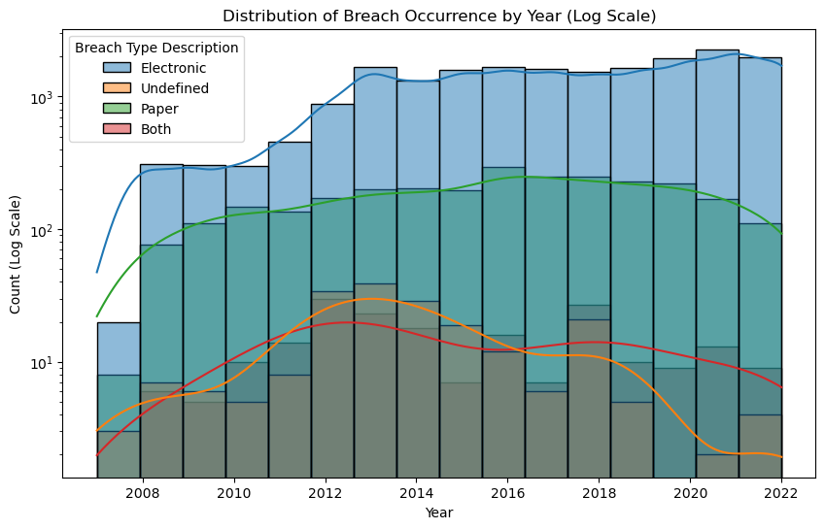
WK09 – Additional Work Done on Data Exploration
EDA plot 1 is now has the correct bin size, so there are no ”missing” data in years.

Slide 118
WK09 – Model 1
What algorithm(s) are you using
Logistic Regression
I tried a decision tree but gave me about the same accuracy score
What settings are you using to train and test your algorithm(s)
Training and testing data was optimized using GridSearchCV
With a test set of 20% and training set of 80%
Random state is 100.
What does my code model
This model uses logistic regression to predict the likelihood of data breaches occurring at the reporting entity based on various features, including breach type and all binary variables. The model is evaluated on the testing data using metrics: accuracy and a classification report (precision, recall, F1-score, support).
What do you expect to get at the output
I expect to get a classification report (training and test) of all classes in organization categories.
What output are you getting
A classification report (training and test) of all classes in organization categories.

Slide 119
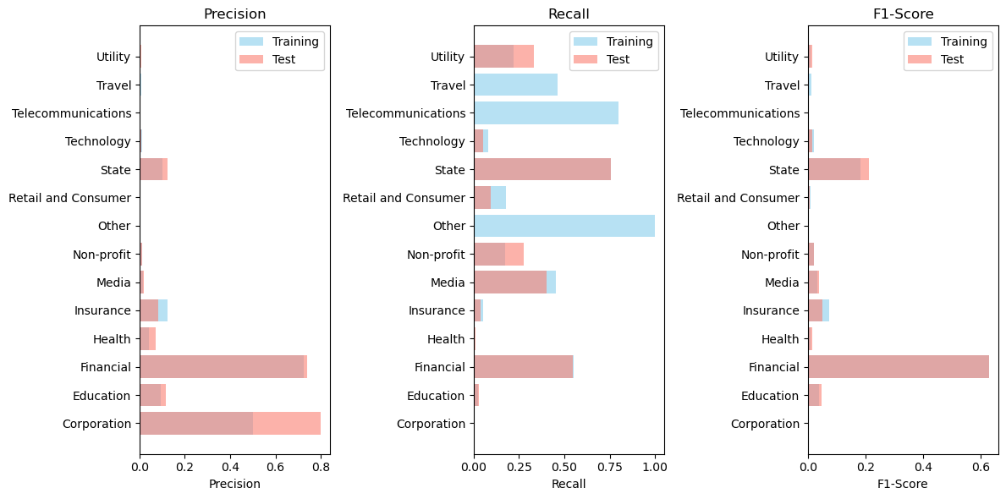
WK09 – Results of the algorithm
Show graphs to explain the output of your algorithm

Slide 120

WK09 – Results of the algorithm (based on work of week 9)
Explain the values obtained for the performance measures (e.g., correlation, accuracy, F-test)
Explain the results
Training Accuracy: The training accuracy is 23.62%. The model correctly predicts the class label for 23.62% of the instances in the training dataset.
Test Accuracy: The test accuracy is 23.94%. The model's accuracy in predicting the class labels for the test dataset is very close to the training accuracy.
Classification Report:
Precision: It measures the accuracy of positive predictions.
A low precision indicates a high number of false positives.
Recall: It measures the ability of the model to identify all relevant instances in a dataset.
Low recall implies a high number of false negatives.
F1-Score: It's the harmonic mean of precision and recall and provides a balance between the two.
A low F1-score suggests an imbalance between precision and recall.

Slide 121
WK09 – Results of the algorithm
How would you improve the results/ What more changes do you need to make to your code or data
Data has some deeper issues.
I’d like some help or perspective on why my accuracy score is so low and what I can try to get better results.

Slide 122
WK09 – Results of the algorithm
Graph of Results

Slide 123
Week - 10

Slide 124
WK10 – Review/revise work from previous week(s)
Below is a summary of changes, trial + error, and solutions
Figured out the issue at hand
Data imbalance was fixed with RandomUnderSampling and Normalizing then Denormalizing Data
Train dataset seemed promising, but Test Dataset is not performing well
When tested, model does not represent the entire cleaned dataset well
This means that there’s an issue with my feature engineering (NLP)
It’s almost impossible to sort all the unique keywords of each organization, which could take another week to do?
I tried finding a database of all organizations within MA or the US to find a category dataset (No Luck)
Next, I tried using Google’s Custom Search Engine JSON API to scrape the web for categorical keywords.
This was somewhat successful due to it finding the keywords or phrases needed to categorize them better, but the API gives you a total of 100 free searches a day. This would mean to sort through the 23,000 rows in the column “Organization Name” it would be $200 to do so.
Therefore, the main issue is the engineering of the feature “Organization Categories” which relies on the keywords sorted by NLP. The keyword dictionaries would need to be detailed enough to represent the entire dataset. (There are ~8000 unique keywords)
The most feasible option might be to reduce the dataset itself to only cover 1-2 years instead of 2007-2022. (reducing the number of unique keywords)
Keeping the Outliers helped the score of both datasets (the variance actually helps in this case)

Slide 125
WK10 – What was done for this week
Below is a summary of what was done this week
Reduced the dataset to only cover 2020-2022
Make keyword dictionaries for the organization names manually for NLP to categorize them.
Found all unique keywords using simple python code along with pandas
Things are looking up; the model IS done in theory.
I have an abstract written down, but things will change down the line.
This NLP category issue is complex
Some organizations belong to several categories
Most of the organizations belong to multiple categories (chose not to because it causes more issues for the model)
If I only leave the majority classes, the model does best?
Should I go with this option? (this kind of ruins the whole point of the research question)
I strongly believe that the NLP issue is sufficient evidence that the model soley relies on this complex issue in the feature engineering. (It changes the percentage drastically)

Slide 126
WK10 – Project Purpose and Questions
Research questions
Are certain organizations more susceptible to data breaches than others?
How effective are strategies like Data Encryption and Credit Monitoring in preventing or mitigating data breaches?
Can the predicted output explain patterns and motivations behind organized data breaches and insights about their targets?
Project Objectives
Evaluate organizational type susceptibility to data breaches.
Measure the effectiveness of data protection strategies.
Gain insights into patterns and motivations behind organized data breaches.

Slide 127

WK10 – Project Workflow Update

Slide 128

WK10 – Code Workflow Update

Slide 129
WK10 – Model
What algorithm(s) are you using
Decision Tree
What settings are you using to train and test your algorithm(s)
Training and testing data
With a test set of 60% and training set of 40%
Random state is 100
The model performed best with these hyperparameters
What does my code model
This model uses a decision tree to predict the likelihood of data breaches occurring at the reporting entity based on various features, including breach type and all binary variables. The model is evaluated on the testing data using metrics: accuracy and a classification report (precision, recall, F1-score, support).
What do you expect to get at the output
I expect to get a classification report (training and test) of all classes in organization categories.
What output are you getting
A classification report (training and test) of all classes in organization categories.

Slide 130
WK10 – Results of the algorithm
Show graphs to explain the output of your algorithm

Slide 131
WK10 – Results of the algorithm
Show graphs to explain the output of your algorithm

Slide 132
WK09 – Results of the algorithm (based on work of week 9)
Training Set:
The overall training accuracy is approximately 70%.
The classification report provides metrics for each class, including precision, recall, and F1-score. These metrics give insights into how well the classifier is performing for each class.
The "Finance" class has a relatively low recall (0.85), indicating that the model is not effectively capturing all instances of this class. This suggests that the model may be better at predicting other classes.
The "Technology" class has a high precision (0.92) but a low recall (0.35), suggesting that when the model predicts this class, it is often correct, but it misses many actual instances of this class.
The "Healthcare" class also has a relatively low F1-score (0.56), indicating a balance between precision and recall.
Test Set:
The overall test accuracy is only about 22.7%. This is significantly lower than the training accuracy, which suggests that the model may be overfitting the training data.
The classification report for the test set shows similar trends as the training set. The "Finance" class, for example, has a high precision but a lower recall.
It's important to note that the imbalanced nature of the dataset, as indicated by the low accuracy and F1-scores for several classes, contributes to the model's poor performance.

Slide 133
WK09 – Results of the algorithm
How would you improve the results/ What more changes do you need to make to your code or data
Find a more efficient way to make the organization name keywords easier to categorize
I think there's a lot more null values than what was said to be by the source.

Slide 134
WK09 – Results of the algorithm
Graph of Results

Slide 135
WK10 – Abstract
Data breaches create significant challenges to organizations, making it necessary to have a proactive approach to mitigate risks and understand the complex dynamics behind these incidents. This study will use machine learning (ML), data cleaning, data transformation, NLP, and other data science techniques to predict data breaches in Massachusetts to gain insights into their patterns and organizational susceptibility. The objectives of this study is to find whether certain organizations are more susceptible to data breaches, the effectiveness of data protection strategies like Data Encryption and Credit Monitoring in preventing or mitigating data breaches, and if the predicted output can elucidate patterns and motivations behind organized data breaches.
To achieve these objectives, we utilized a Decision Tree Classifier on a dataset containing features of the data breaches’ targeted data, breach type, residents affected, and whether security strategies were used. The dataset underwent cleaning, transformation, engineering, feature selection, normalization using scaling, random under sampling, and denormalization. The class imbalance is addressed using random under-sampling to ensure a more balanced representation of organizational categories.

Slide 136
WK10 – Abstract
The results of the model training showed promising performance in predicting data breaches within the training dataset, achieving an accuracy of approximately 70%. Although, the model's performance on the test dataset was significantly lower, with an accuracy of around 23%. This was due to the complex issue of categorizing the organizations using NLP, which showed difficulty in listing the enormous number of unique keywords for the keyword dictionary. A classification report for the training and test revealed variations in the model's performance across different organizational categories.
This research contributes to the field of cybersecurity by emphasizing the susceptibility of various types of organizations to data breaches and what aspects play into the motivations and reasonings. This highlights the need for addressing thorough data collection by agencies, the difficulty of categorizing large amounts of unique keywords, and improving the model's robustness for real-world applications. Future work will involve finding a more practical way to categorize these organizations using NLP, exploring more machine learning models, hyperparameter tuning, and collecting additional data, such as geographical locations, to further enhance predictive accuracy. Finally, the study emphasizes the importance of understanding and addressing the multifaceted challenges created by data breaches in diverse organizational contexts.

Slide 137
Week - 12

Slide 138
WK12 – Review/revise work from previous week(s)
Below is a summary of changes made and slide numbers
Reduced number of categories to just the majority classes.
Randomly select categories
The model performs best with just the “Finance” and “Corporation” classes.
Switched confusion matrixes
Train on left, Test on right
Decreasing order for feature importance plot
Reduced length of report abstract
Includes changes made with model
I re-implemented the Outlier Handling
Helped the model’s performance (Current model with the random class selection code)

Slide 139
WK12 – What was done for this week
Below is a summary of what was done this week
Draft Report
Algorithm Update

Slide 140

WK12 – Project Workflow Update

Slide 141
WK12 – Code Workflow Update

Slide 142
WK12 – Algorithm Update
What algorithm(s) are you using
Decision Tree
What settings are you using to train and test your algorithm(s)
Training and testing data
With a test set of 25% and training set of 75%
Hyper parameter tuning
Max depth = 5
Min samples leaf = 2
Min samples split = 10
The model performed best with these hyperparameters using GridSearchCV
What does my code model
This model uses a decision tree to predict the likelihood of data breaches occurring at the reporting entity based on various features, including breach type and all binary variables. The model is evaluated on the testing data using metrics: accuracy and a classification report (precision, recall, F1-score, support).
What do you expect to get at the output
I expect to get a classification report (training and test) of all classes in organization categories.
What output are you getting
A classification report (training and test) of all classes in organization categories.

Slide 143

WK12 – Results of the algorithm
Show graphs to explain the output of your algorithm

Slide 144


WK12 – Results of the algorithm
Show graphs to explain the output of your algorithm

Slide 145
WK12 – Results of the algorithm
Training Set:
The overall training accuracy is approximately 82%.
Precision:
The precision measures the accuracy of positive predictions.
For "Corporation," the precision is 80%, meaning that 80% of the instances predicted as "Corporation" are correct.
For "Finance," the precision is 83%, indicating that 83% of the instances predicted as "Finance" are correct.
Recall:
The recall (also known as sensitivity) measures the ability of the model to correctly identify positive instances.
For "Corporation," the recall is 84%, indicating that 84% of actual "Corporation" instances are correctly identified.
For "Finance," the recall is 79%, indicating that 79% of actual "Finance" instances are correctly identified.
F1-Score:
The F1-score is the harmonic mean of precision and recall.
For "Corporation," the F1-score is 0.82, and for "Finance," it's 0.81.
There is a balance between precision and recall for both classes.

Slide 146
WK12 – Results of the algorithm
Test Set:
The overall training accuracy is approximately 79%.
The classification report for the test set shows similar trends as the training set. The "Finance" class, for example, has a high precision but a lower recall.
Training Accuracy | 0.7964472917880023
Test Accuracy | 0.7856918732350172
 | Precision | Recall | F1-Score | Support
Corporation | 0.79 | 0.81 | 0.80 | 3434
Finance | 0.81 | 0.78 | 0.79 | 3434
accuracy |  |  | 0.80 | 6868
macro avg | 0.80 | 0.80 | 0.80 | 6868
weighted avg | 0.80 | 0.80 | 0.80 | 6868
 | Precision | Recall | F1-Score | Support
Corporation | 0.67 | 0.82 | 0.74 | 1164
Finance | 0.88 | 0.77 | 0.82 | 2023
accuracy |  |  | 0.79 | 3187
macro avg | 0.77 | 0.79 | 0.78 | 3187
weighted avg | 0.80 | 0.79 | 0.79 | 3187

Slide 147
WK12 – Results of the algorithm
How would you improve the results/ What more changes do you need to make to your code or data
Find a more efficient way to make the organization name keywords easier to categorize
I think there's a lot more null values than what was said to be by the source.
Explanation
The model appears to perform reasonably well on the selected classes "Corporation" and "Finance.”
Both classes have fairly high precision and recall values, indicating that the model is effective at correctly classifying these two classes.

Slide 148

WK12 – Results of the algorithm
Graph of Results

Slide 149
WK12 – Abstract
Data breaches pose challenges for organizations, necessitating a proactive approach to mitigate risks and grasp the underlying dynamics. This study uses machine learning, data science techniques, and NLP to predict Massachusetts data breaches, aiming to uncover patterns and susceptibility. Organizational susceptibility, data protection strategies, and motivations behind data breaches will be investigated. A Decision Tree Classifier on a cleaned, transformed, and normalized dataset with balanced representation was employed. The model achieves 81% accuracy in the training dataset and 80% in the test dataset, with only the two majority classes “Finance” and “Corporation”. This research emphasizes the need for comprehensive data collection, improved NLP, and model robustness. Future work will involve finding a more practical way to categorize these organizations using NLP, exploring more machine learning models, hyperparameter tuning, and collecting additional data, such as geographical locations, to further enhance predictive accuracy. Finally, the study emphasizes the importance of understanding and addressing the multifaceted challenges created by data breaches in diverse organizational contexts.

Slide 150
WK12 – Draft paper
Draft paper was sent as a separate submission on Blackboard

Slide 151
Week - 13

Slide 152
WK13 – What was done for this week
Below is a summary of what was done this week
Completion of the Draft IEEE formatted Report
Completion of the Draft Final Presentation
Only have a question about the review past works section.

Slide 153

WK13 – Project Workflow Update
Although the model didn’t perform as well, I did get a free trial for Runway, a MLOps software, to learn how to deploy my model. I am currently playing around and understanding the software.

Slide 154

WK13 – Code Workflow Update

Slide 155
WK13 – Additional Work Done on the Algorithm/Results
I ended up having three options for my result choice to add to my report and presentation.
Option 1
The model results from WK 12 with only finance and corporation classes.
Although the corporation class is redundant in terms of classification, the keywords do cover a good bit of the samples within the dataset.
Accuracy for both testing and training datasets are around 80%.
This model includes using undersampling, normalizing>denormalizing, and GridSearchCV hyperparameter techniques.
This model does not entirely cater to my objective of evaluating the susceptibility of organization types to data breaches.
Option 2
This model also includes using undersampling, normalizing>denormalizing, and GridSearchCV hyperparameter techniques.
Only difference is it has only the Finance, Healthcare, and Other (Other misc. corporations) classes.
Accuracy for both testing and training datasets are around 60%.
This model seems like the best choice for my model because of how realistic the results are within the classification report
Option 3
This model includes normalizing>denormalizing, and GridSearchCV hyperparameter techniques, but NOT the undersampling technique.
This also has the Finance, Healthcare, and Other (Other misc. corporations) classes.
Accuracy for both testing and training datasets are around 70%, but the precision and recall for the Healthcare class becomes a lot lower.
This model has a higher accuracy and is similar to option 2 but does not capture the precision and recall realistically for the healthcare class.
A p-value is not required for this model due to the classification report being more important to reach the objectives for predicting data breaches and evaluating aspects/features.

